Slide 1

nothing is ever in plain language
4.043 Interaction Intelligence LLO
Joshua Rivera Camacho, Elaine Liu, Krystal Montgomery

Slide 2


Slide 3
is what someone says ever what they really mean?
en clair is a device for that gap: slot in a filter, describe how you want to hear the world, and everything retranslates. every conversation has always been a translation.
nothing is ever in plain language.
Notes:
Short paragraph describing your LLO. Articulate in what ways your LLO makes LLMs physical, how does it improve or challenge AI capabilities.

Slide 4
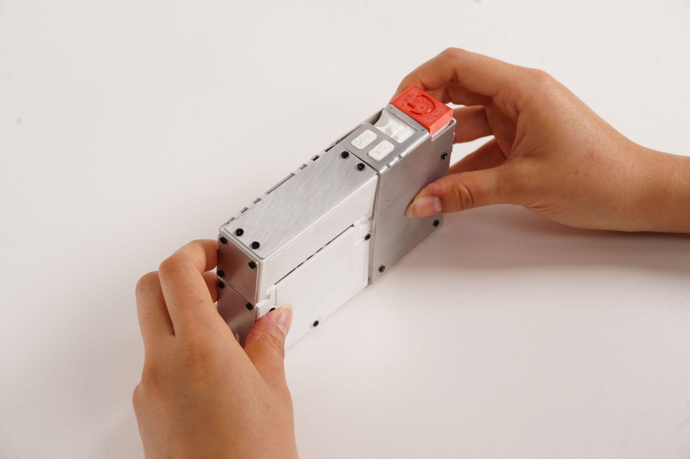

Slide 5


Slide 6
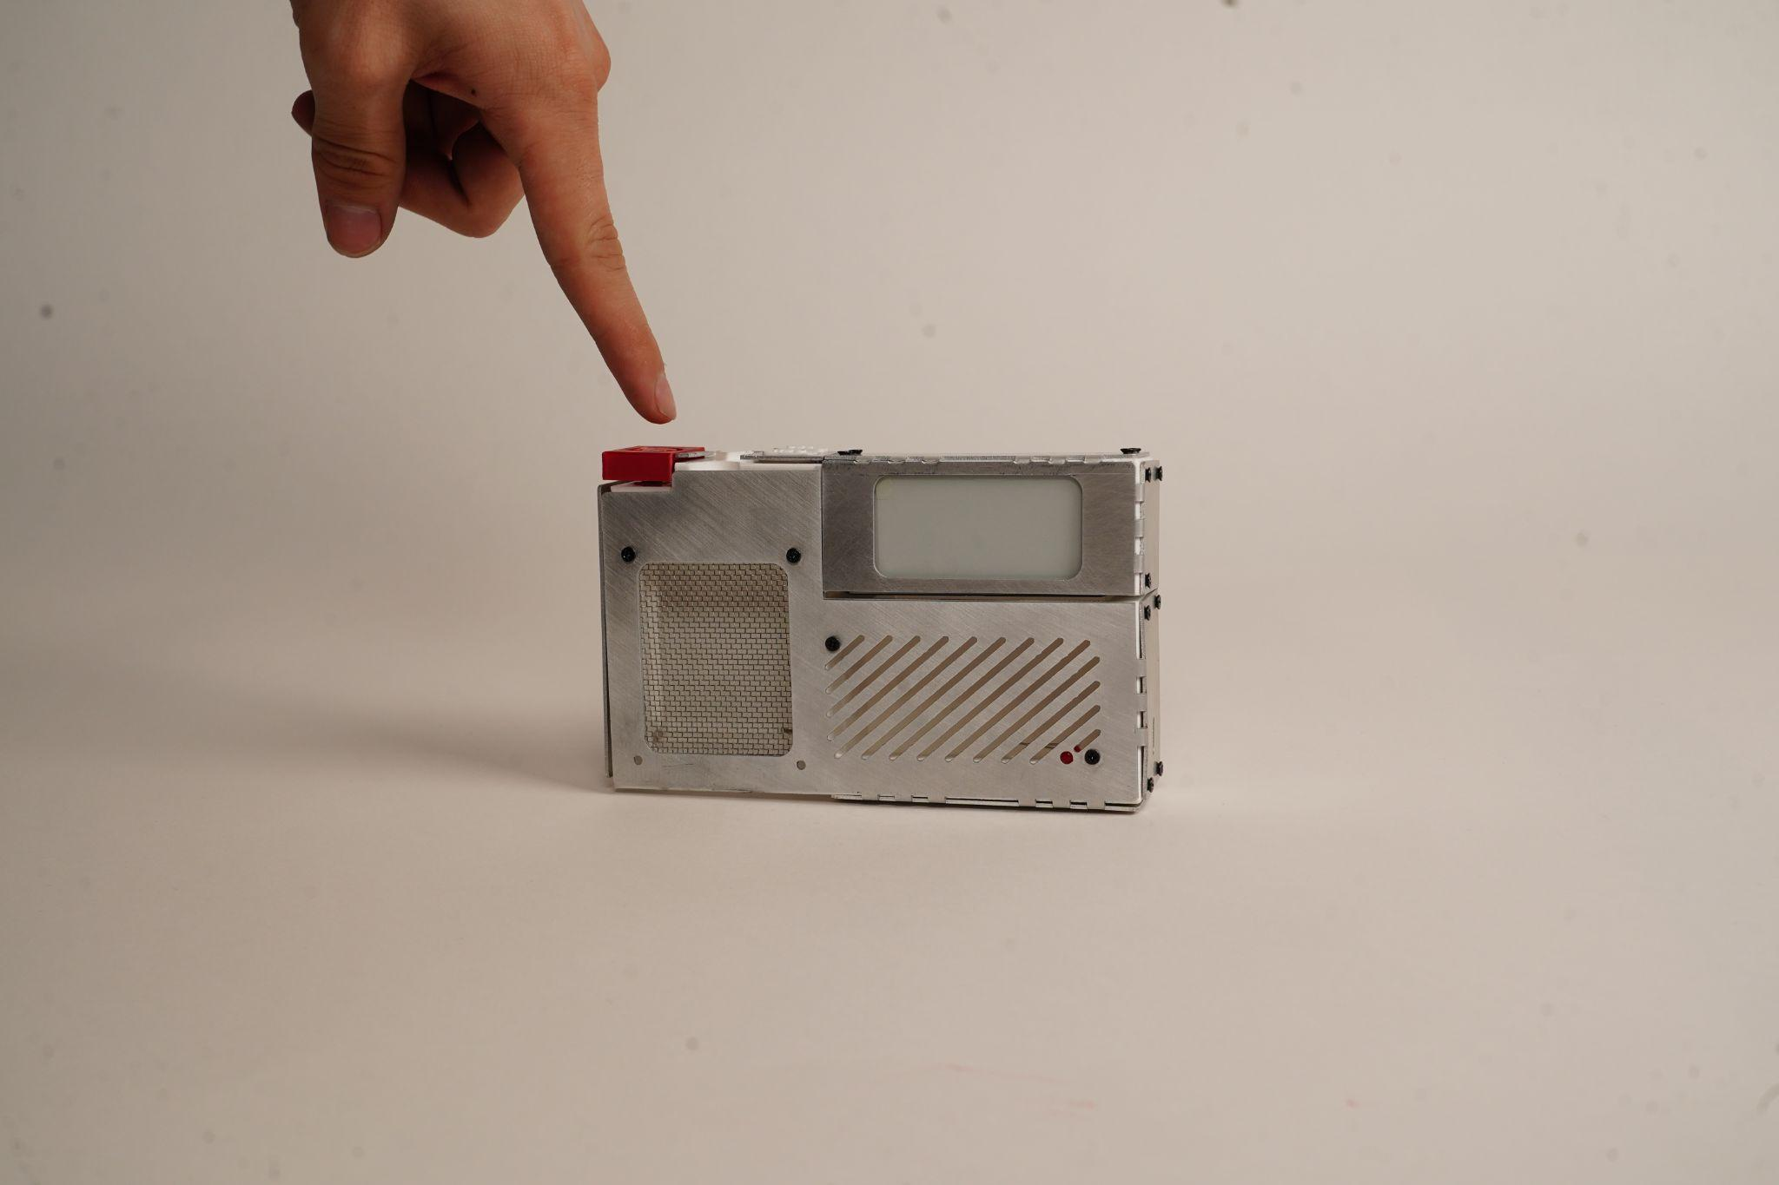

Slide 7
inspiration

Slide 8
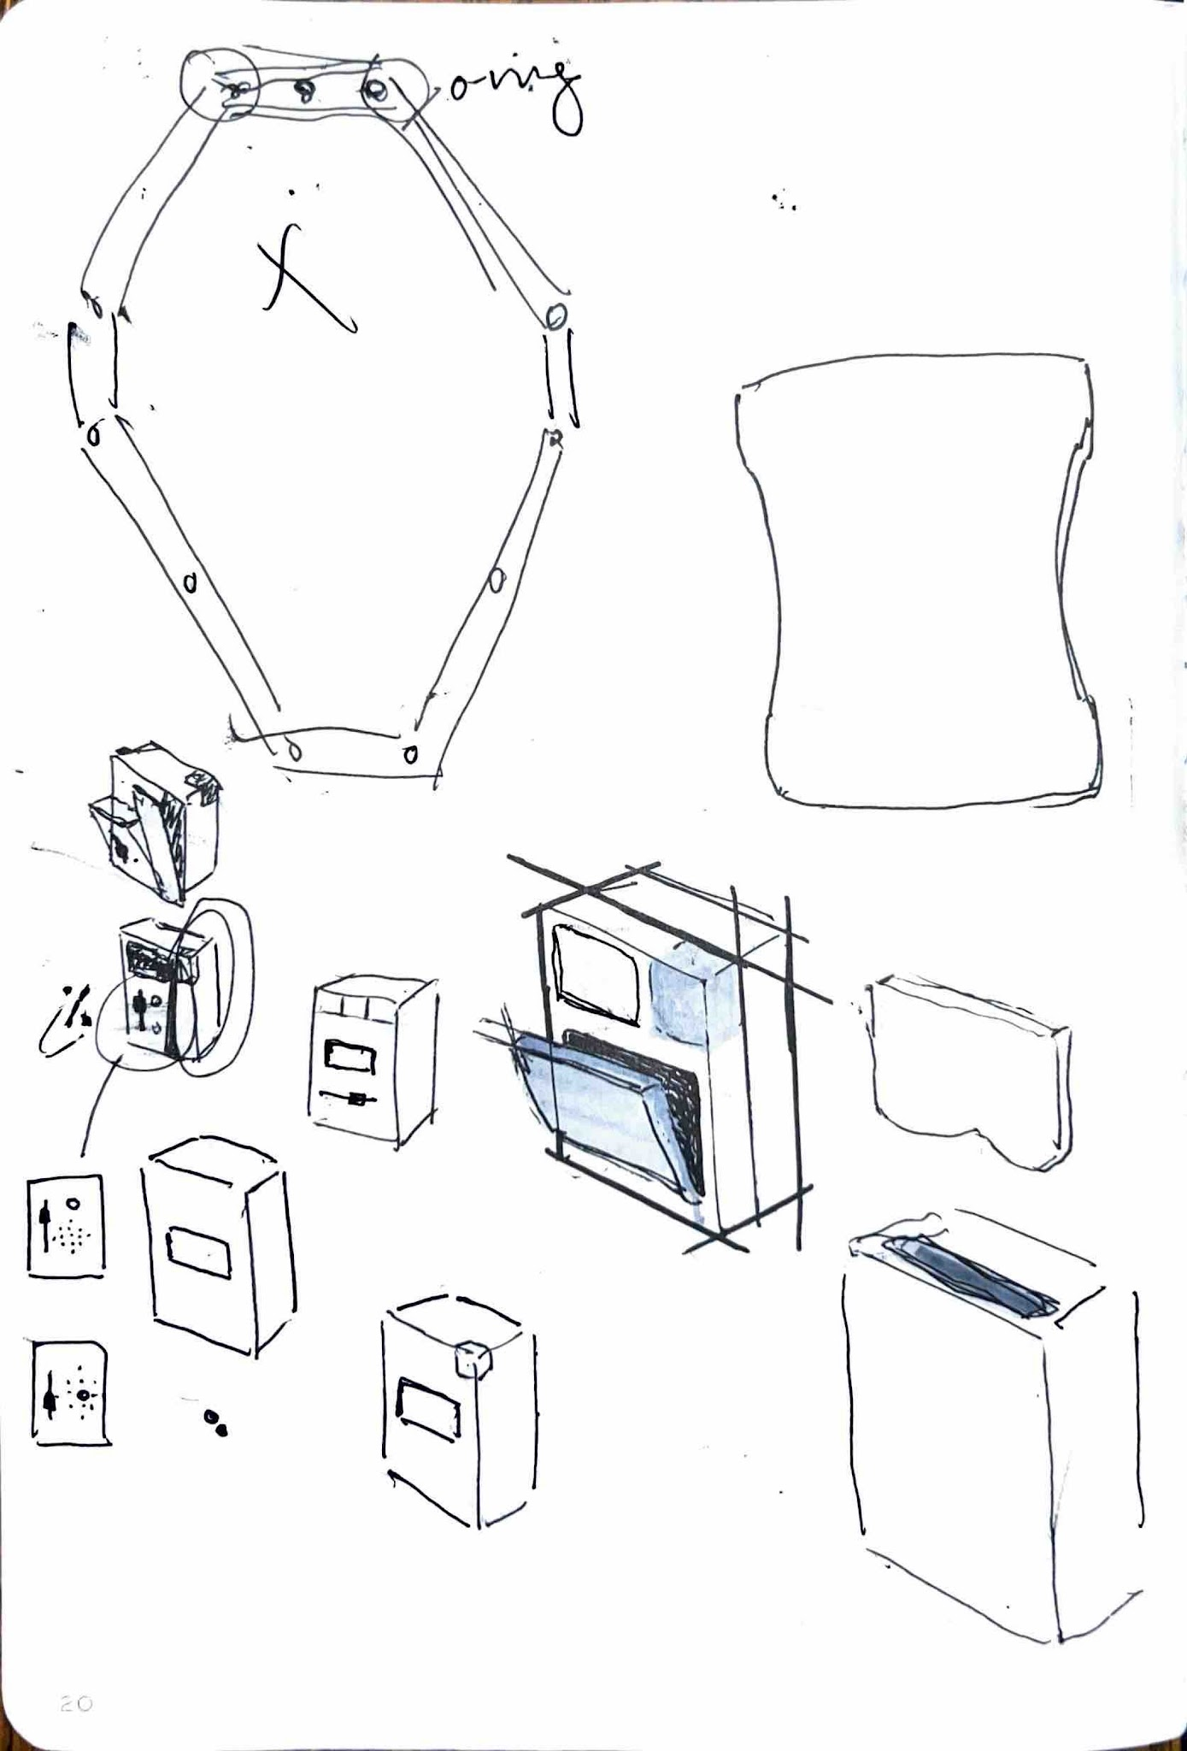
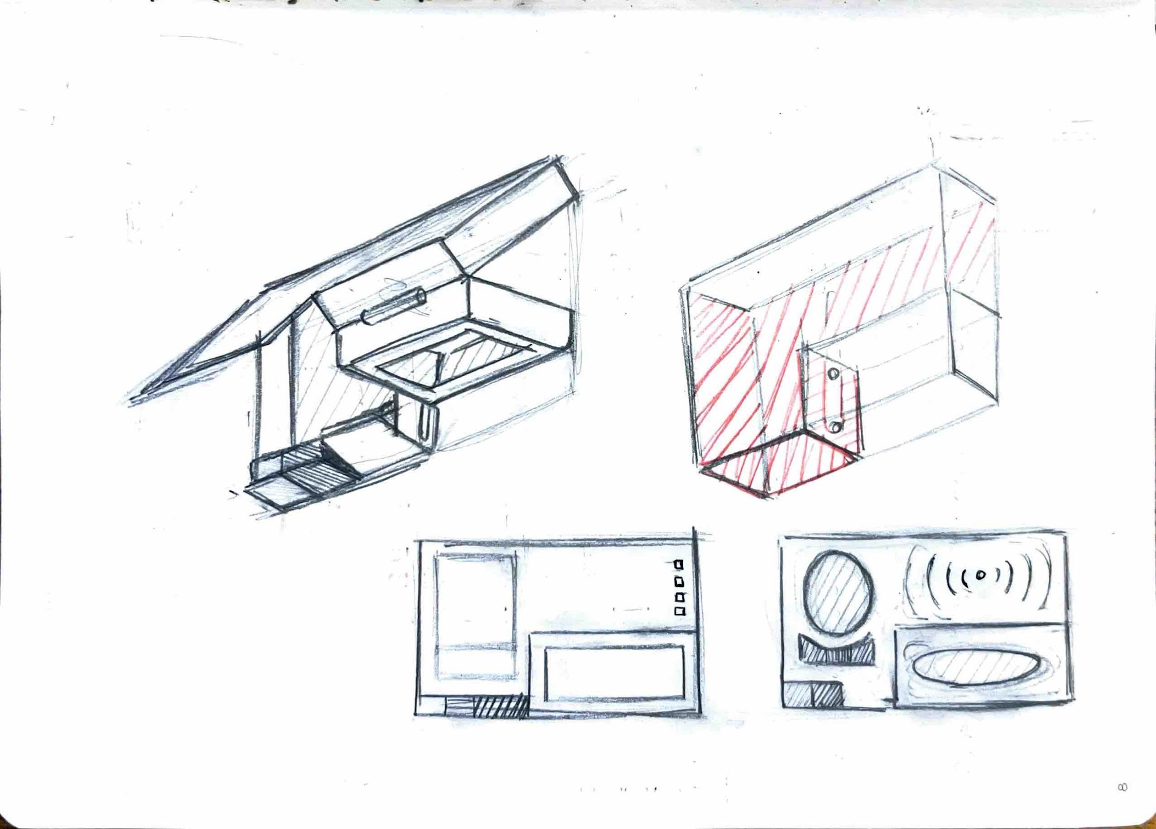
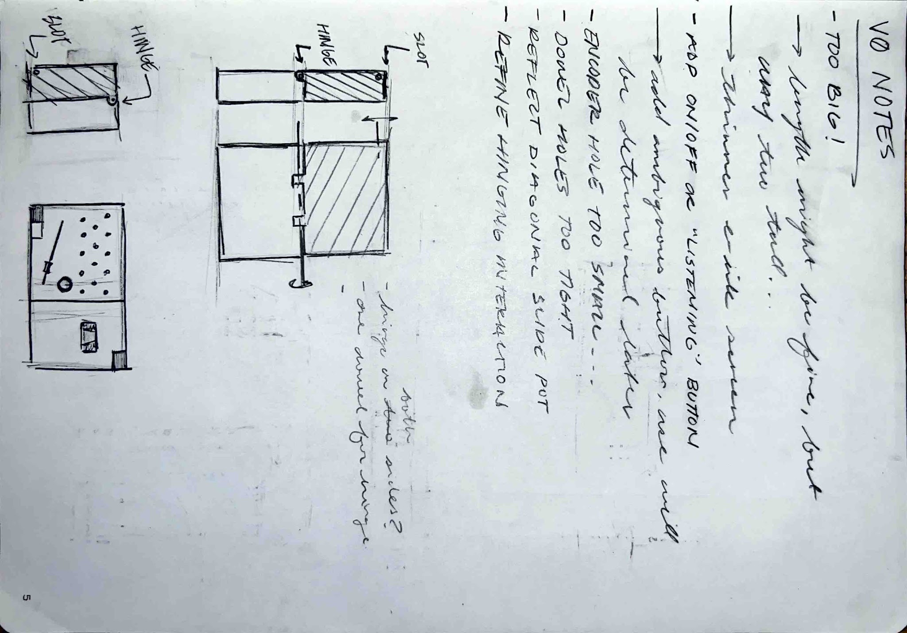
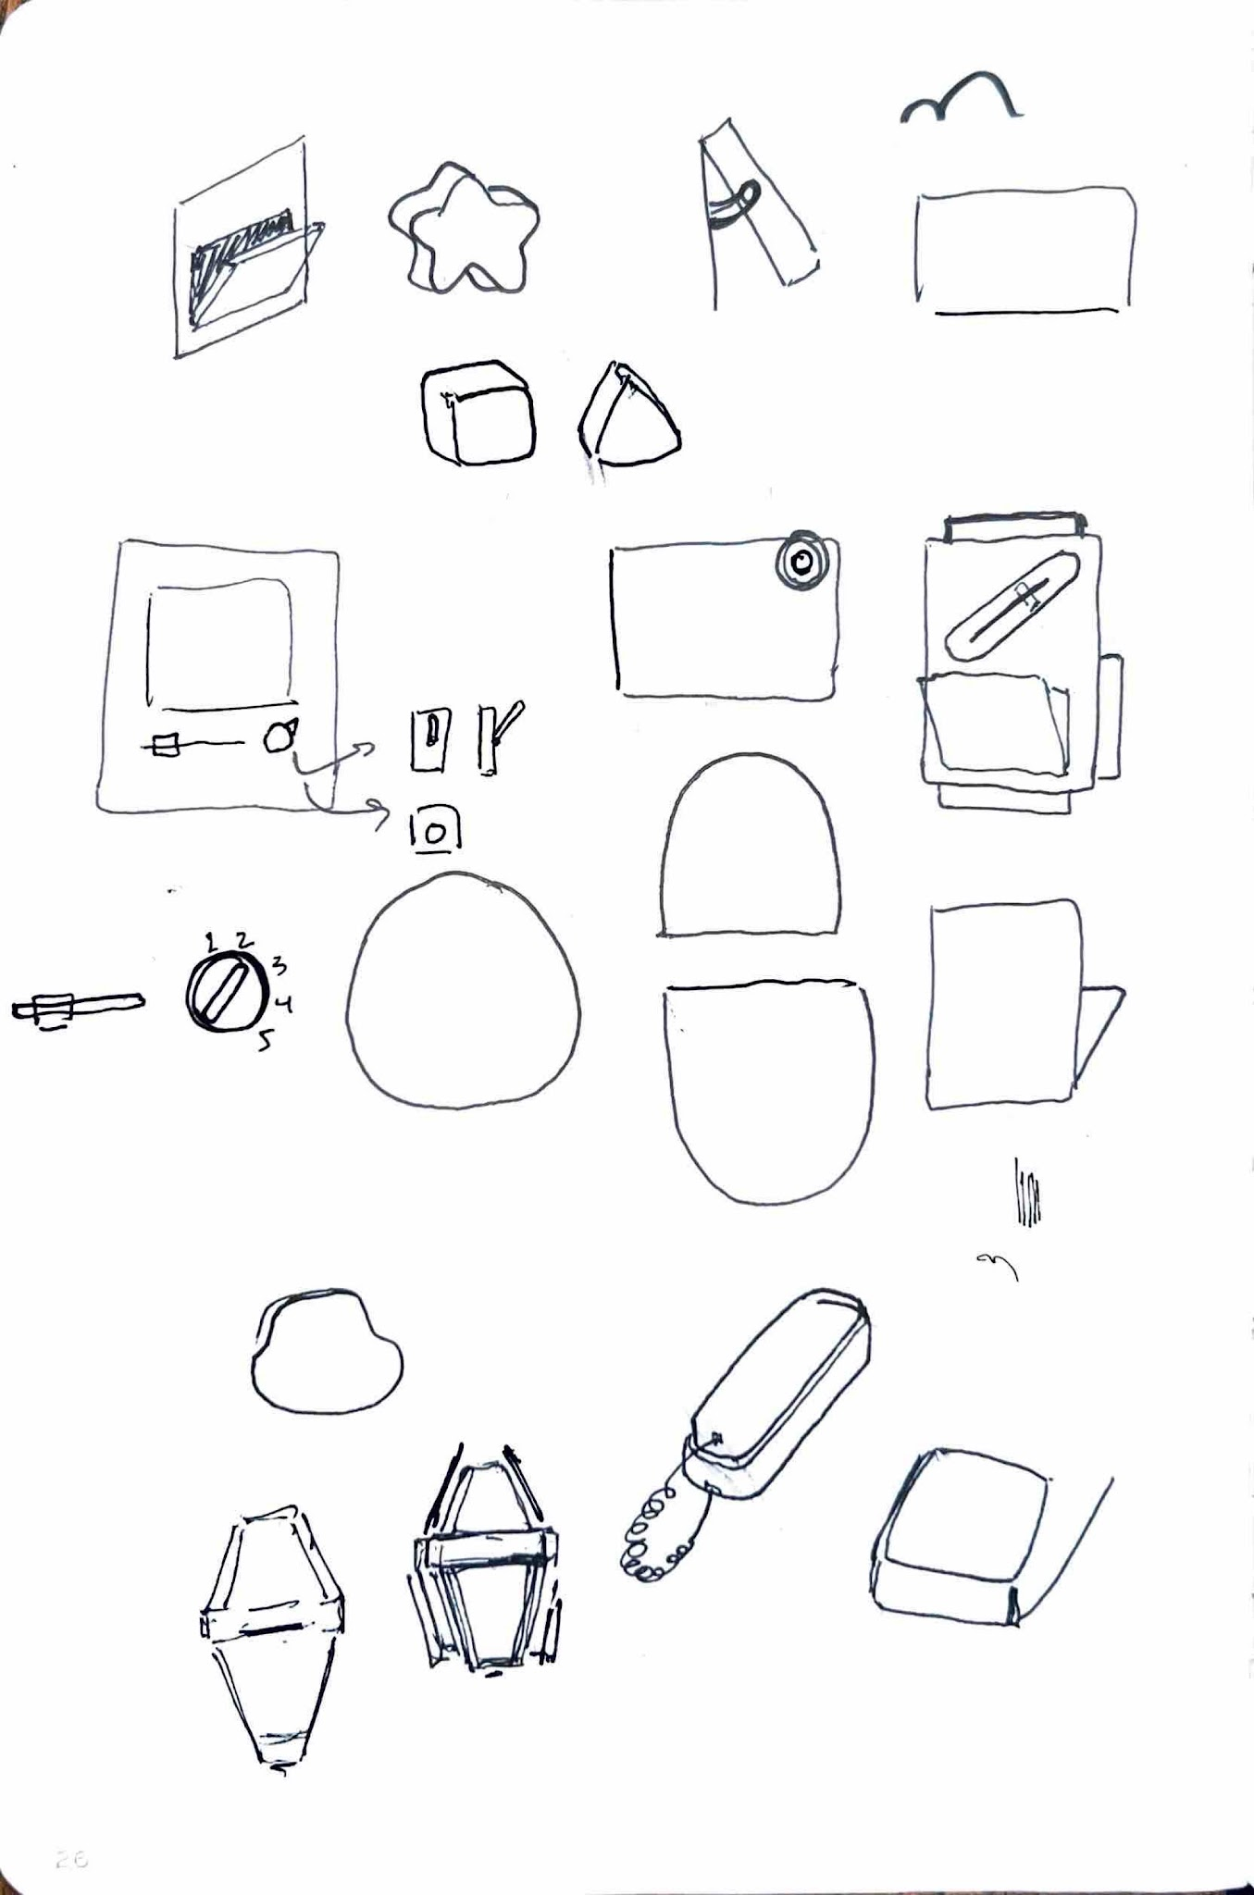
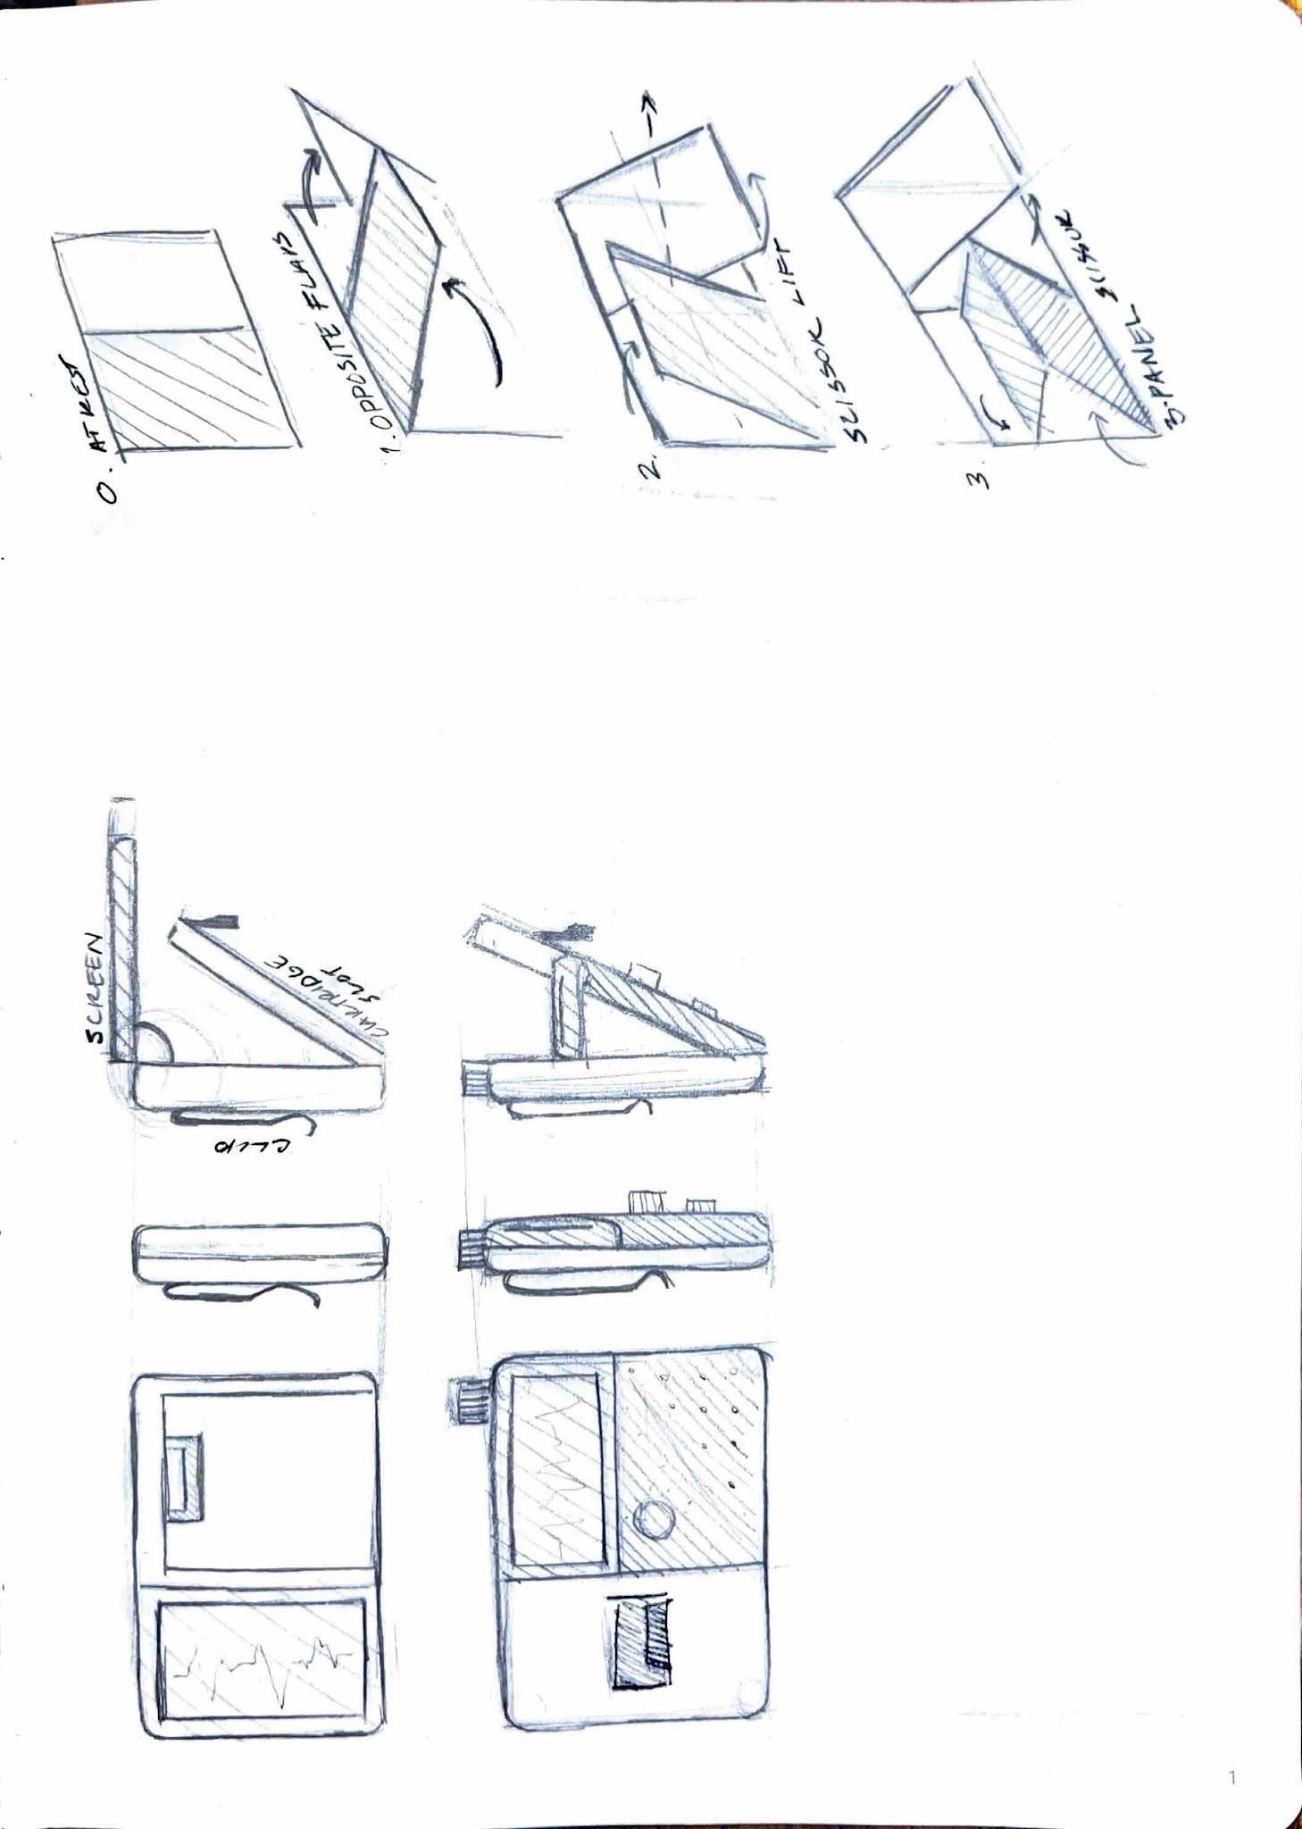
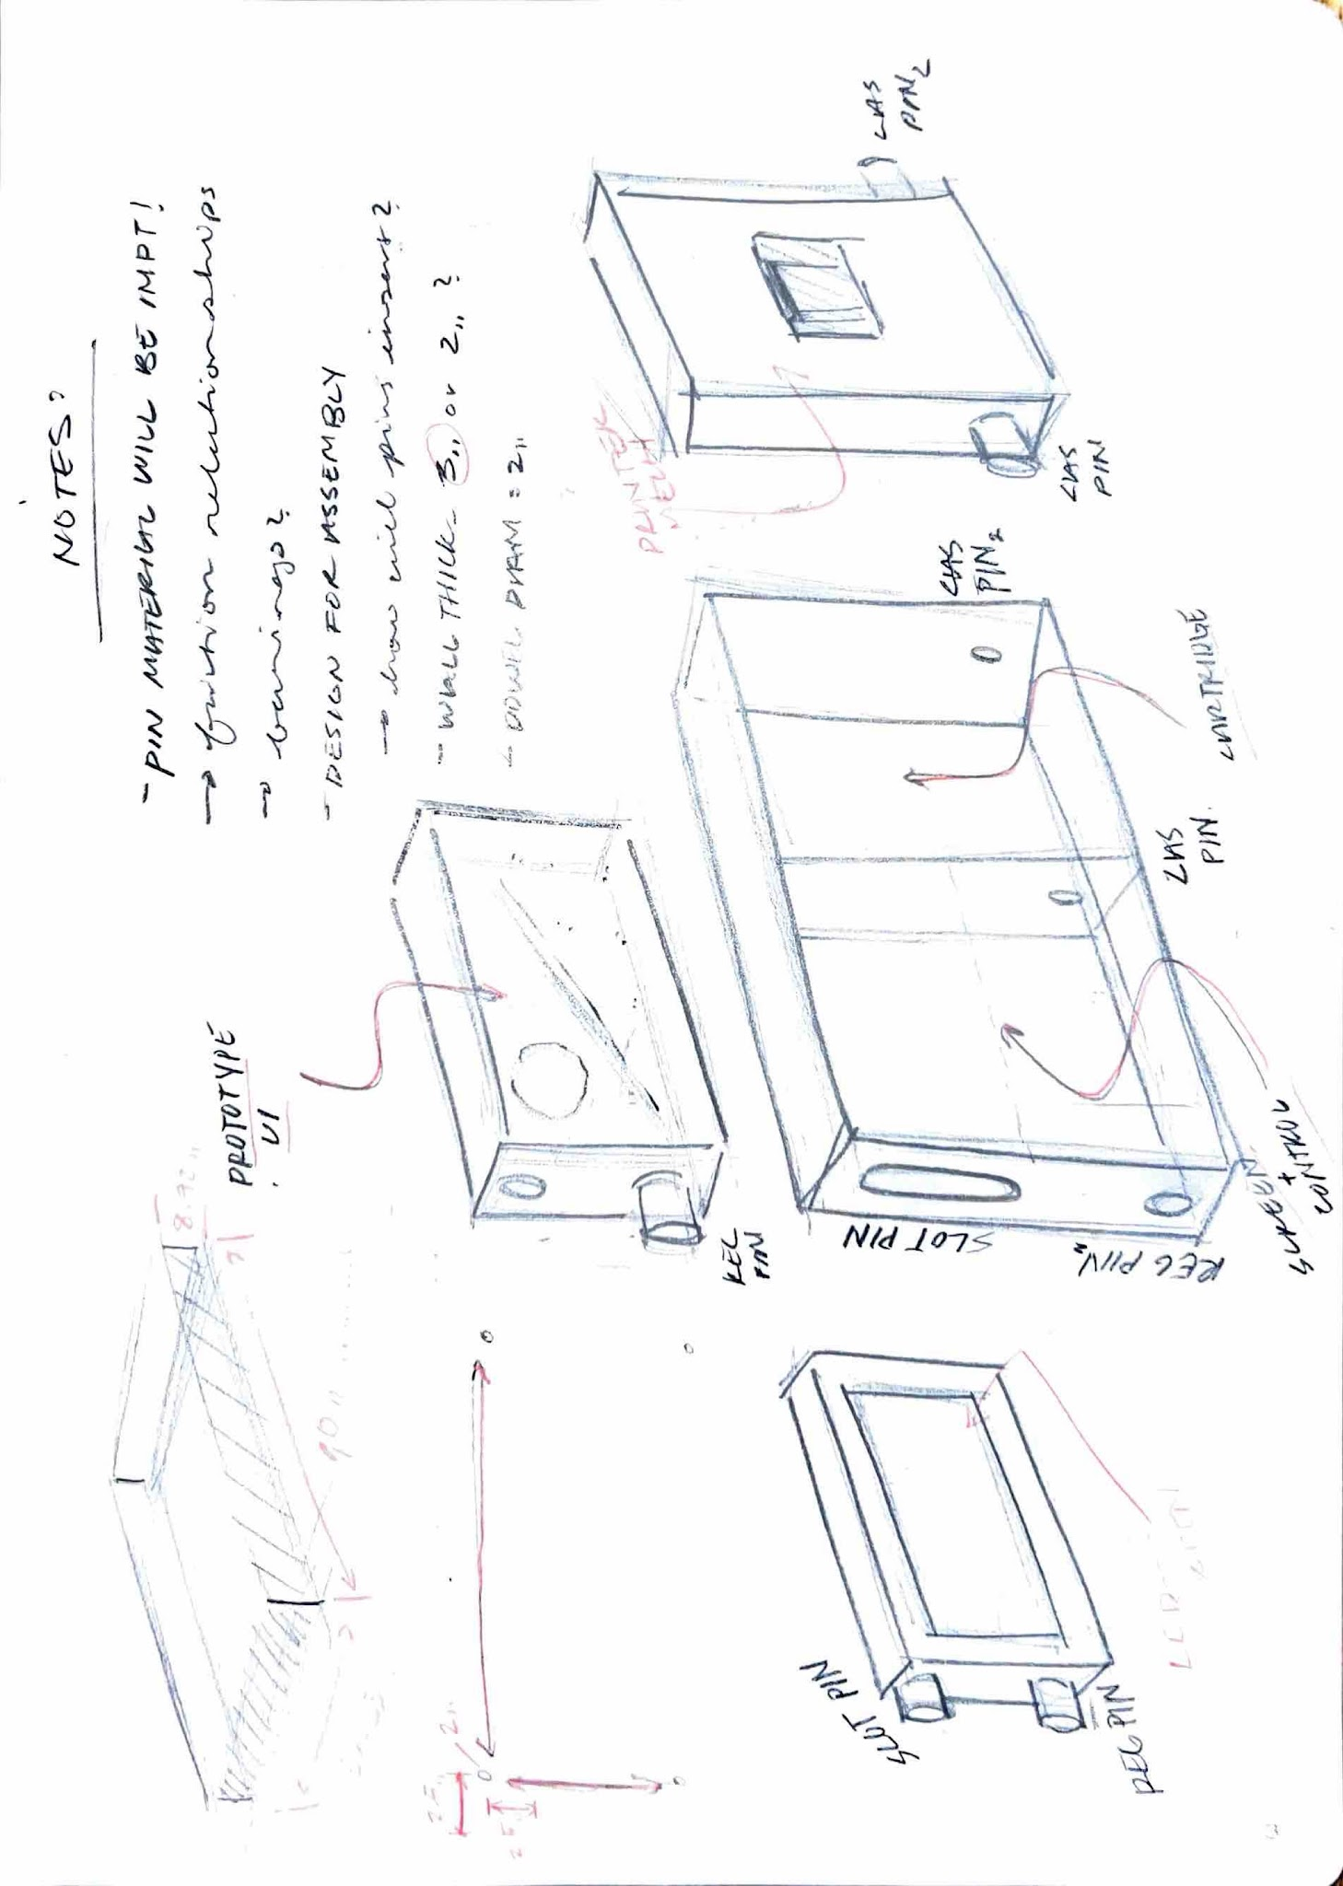
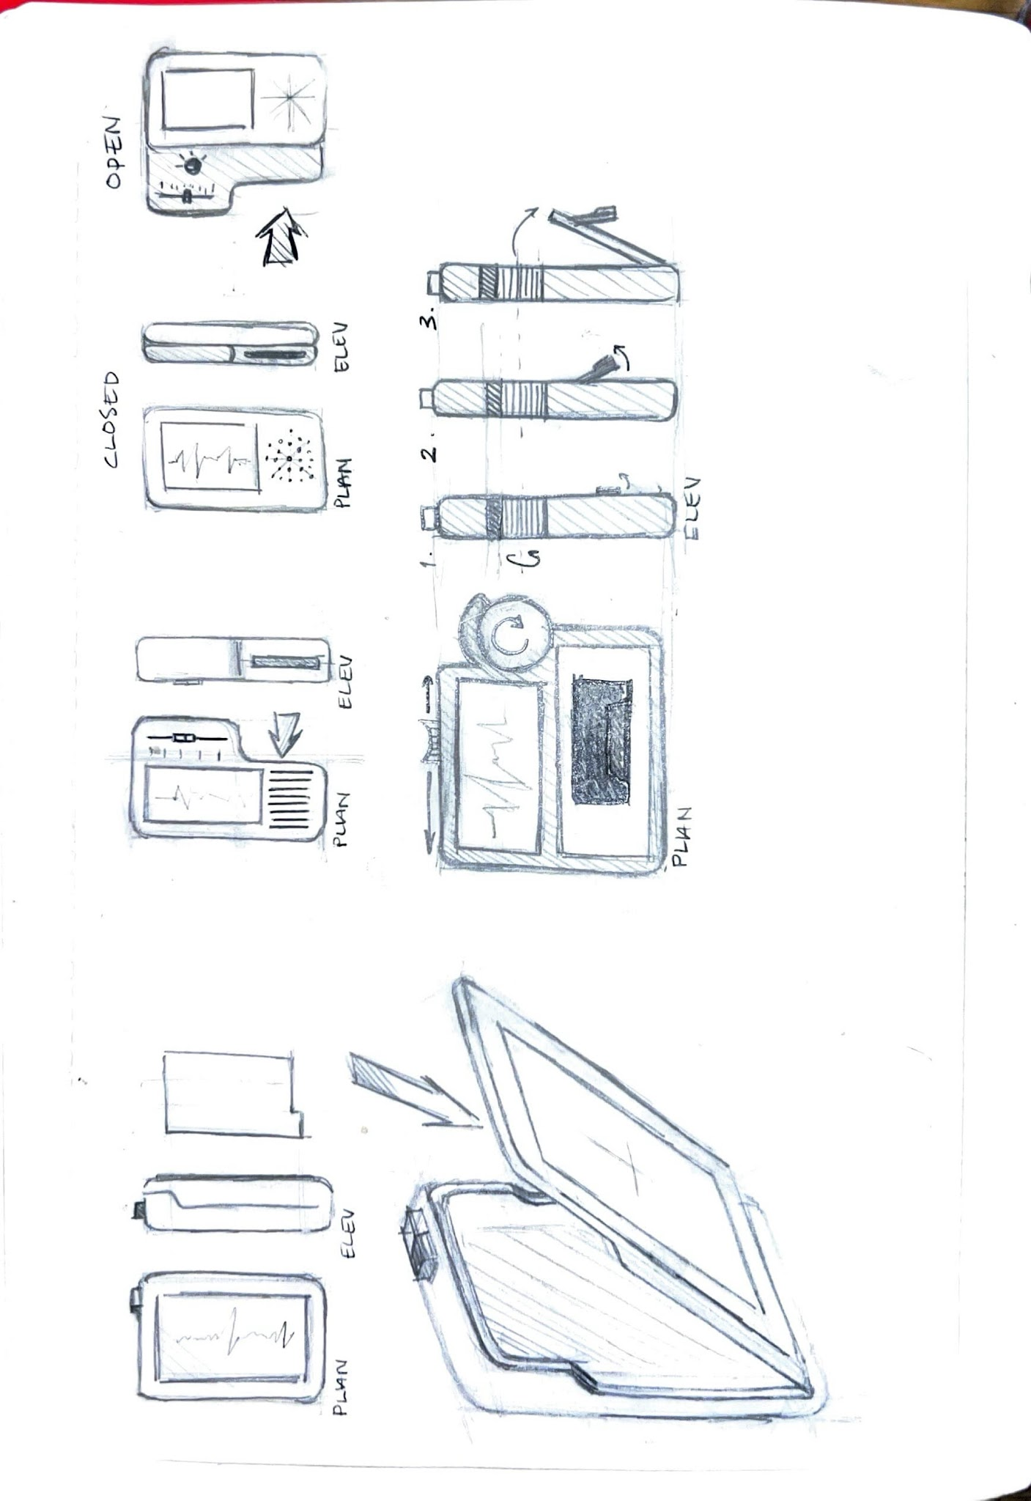
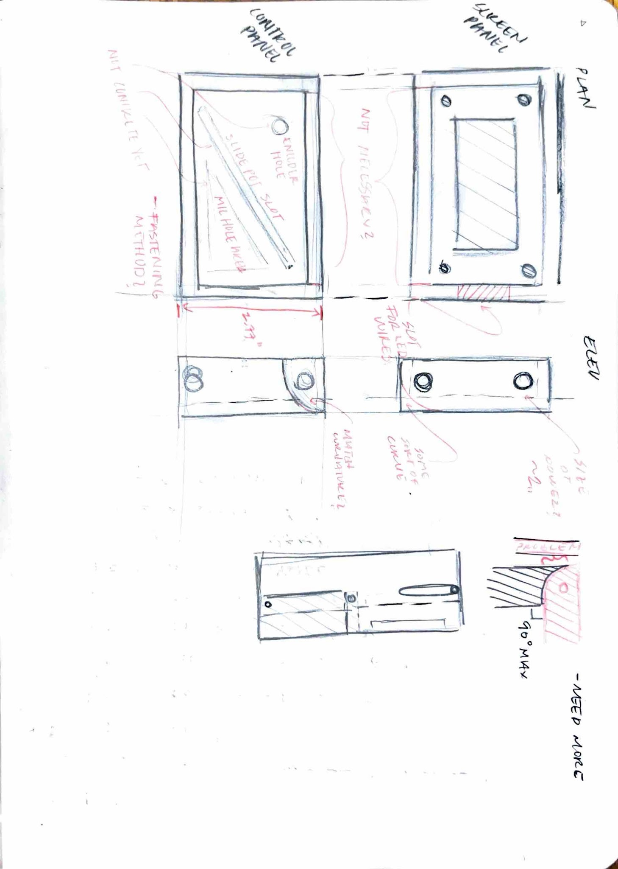

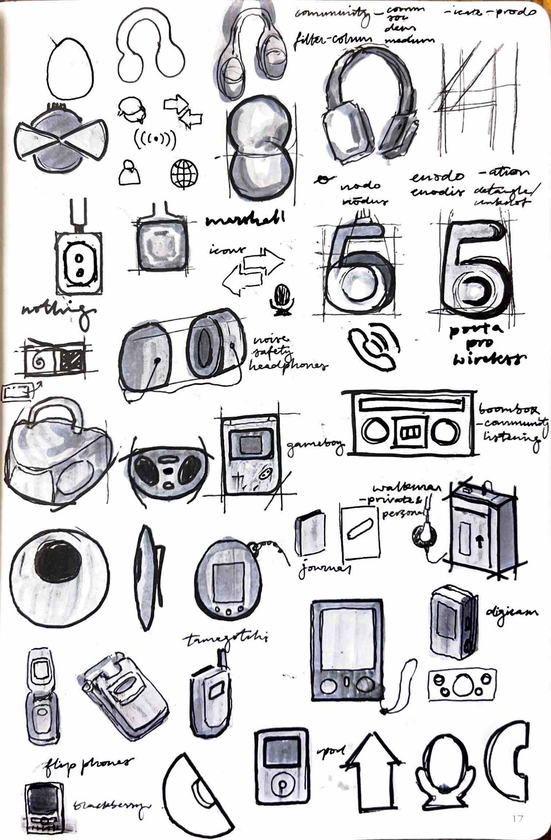
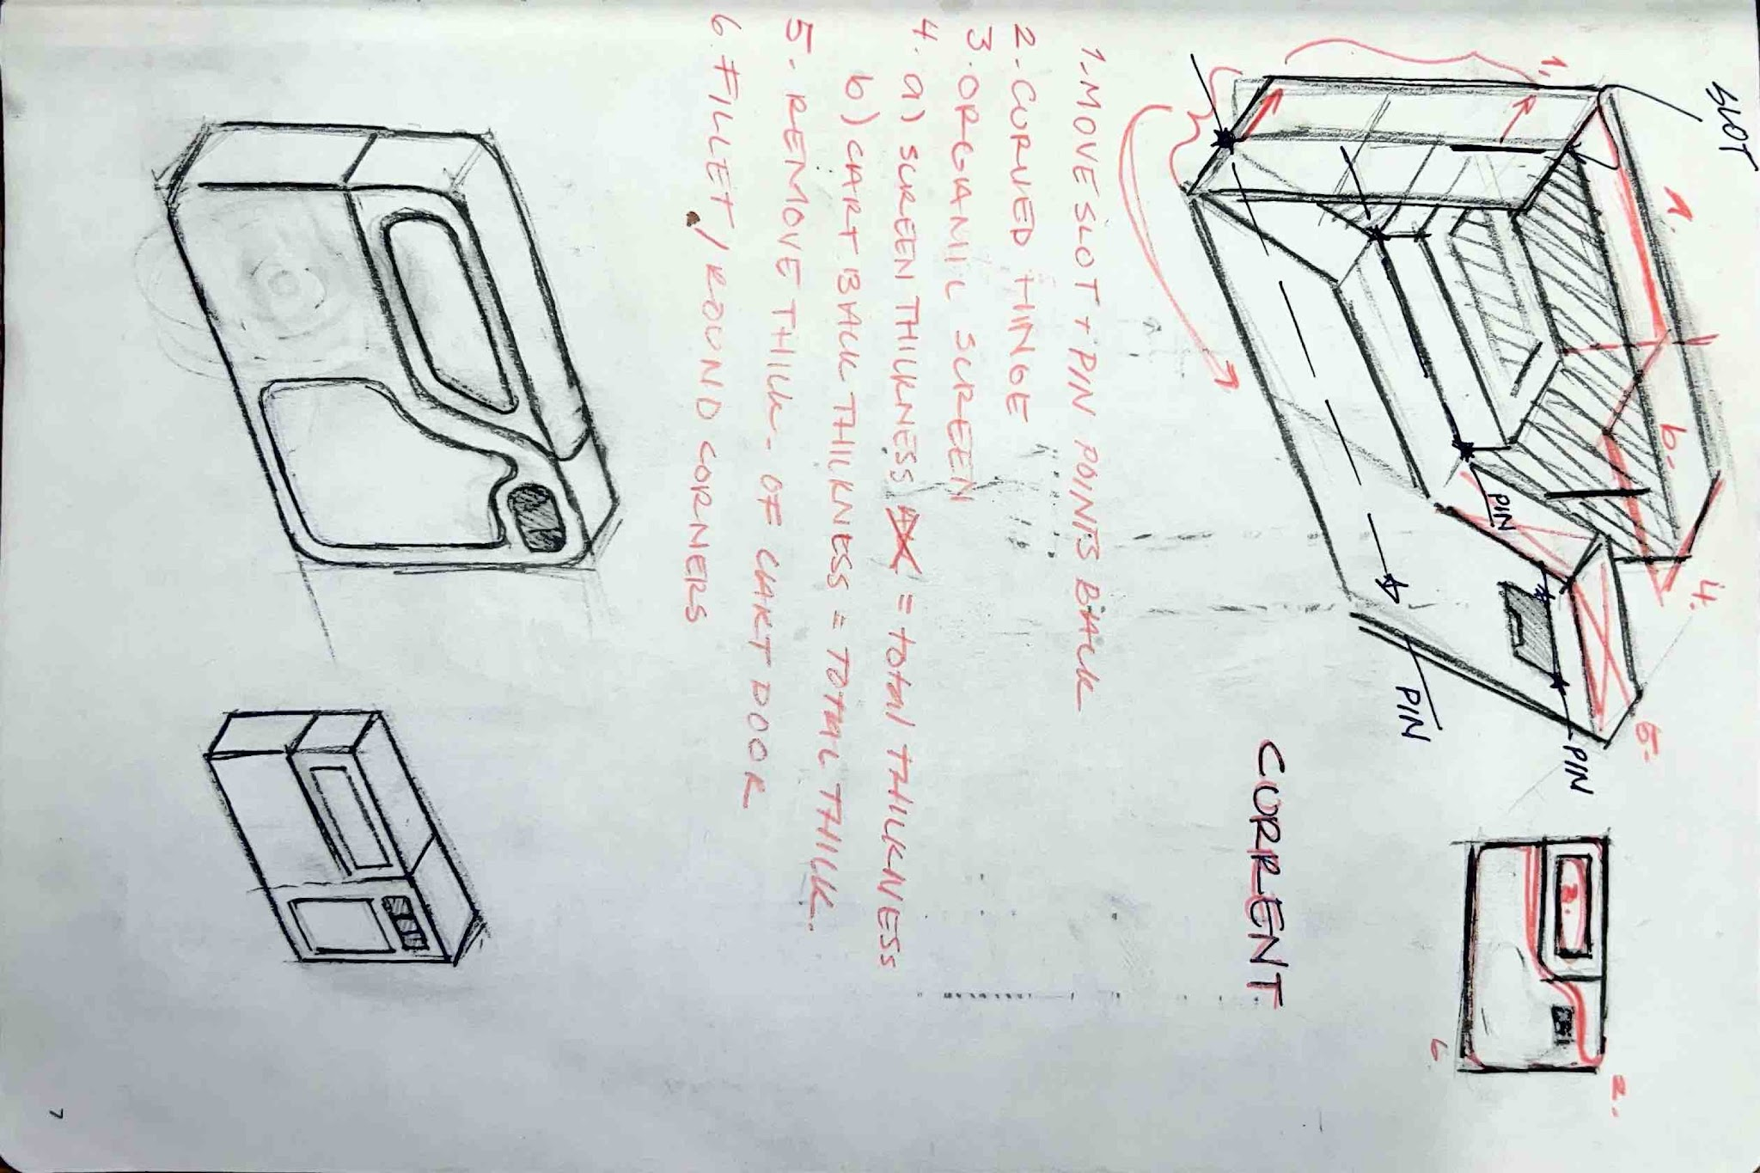
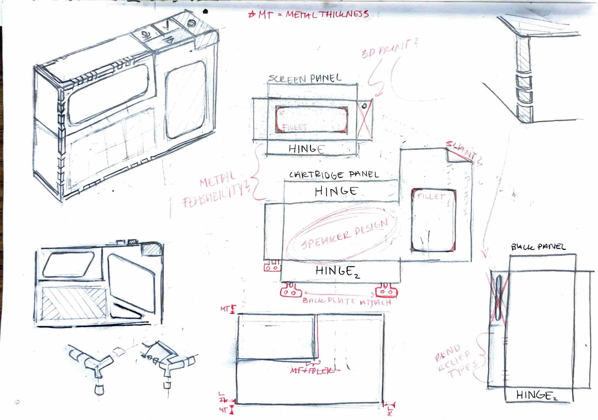
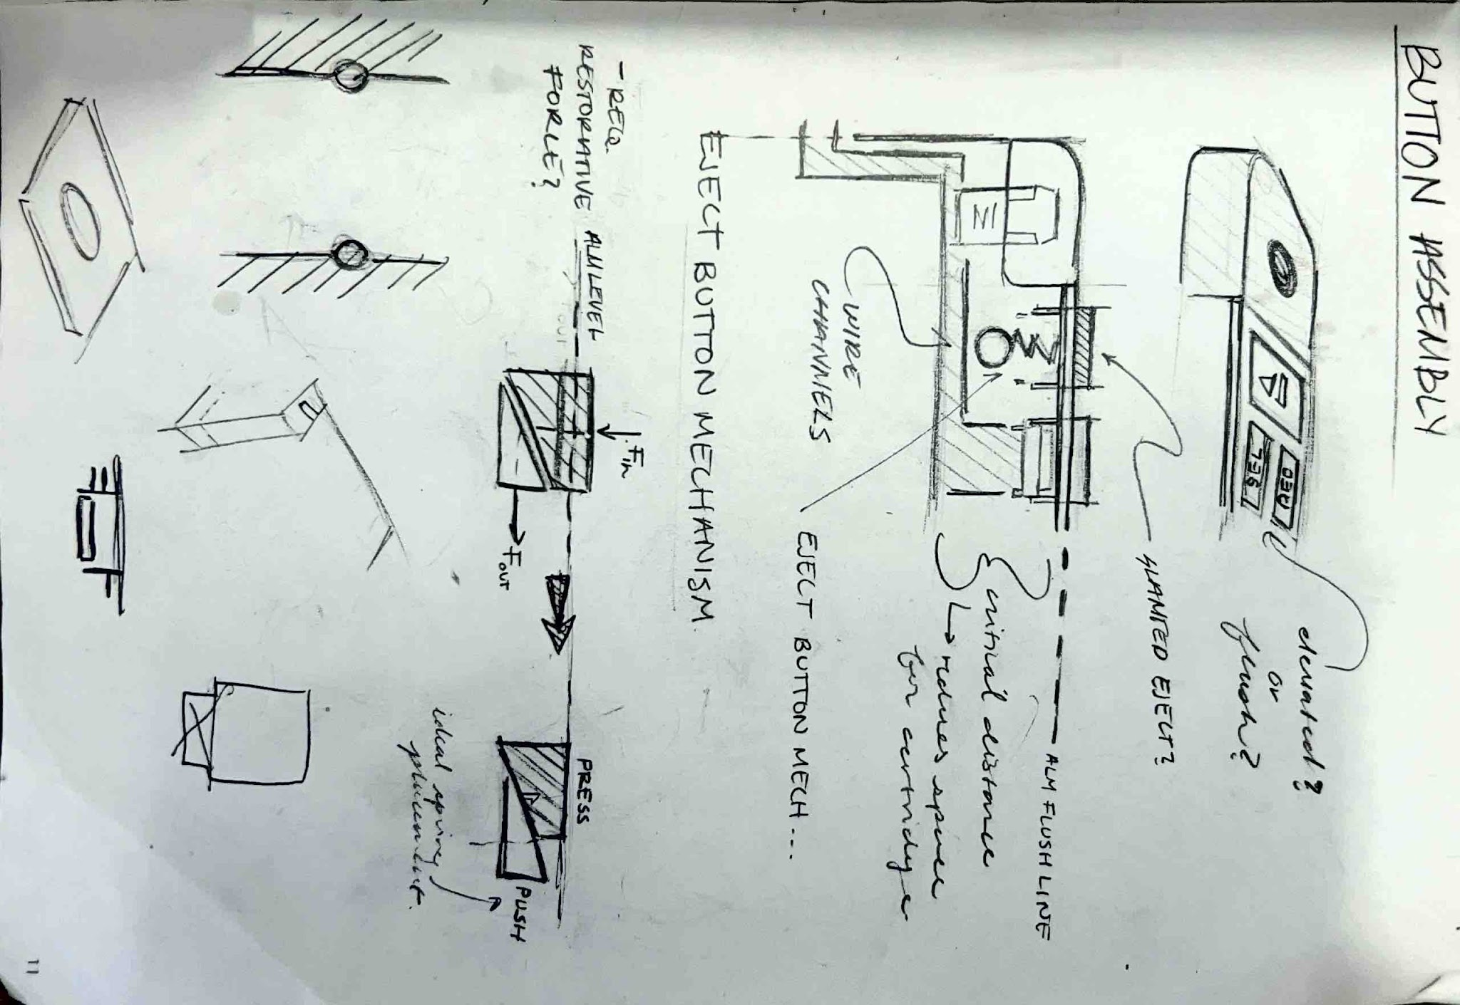

Slide 9
how it works

Slide 10
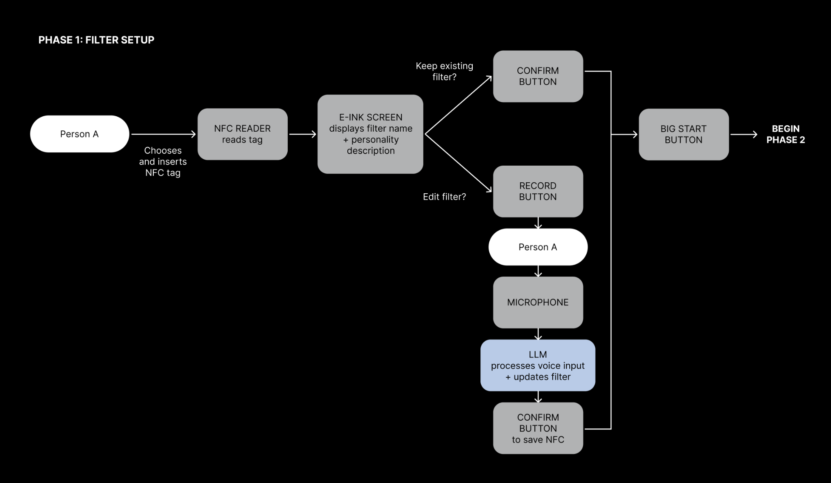
phase 1: filter setup

Slide 11
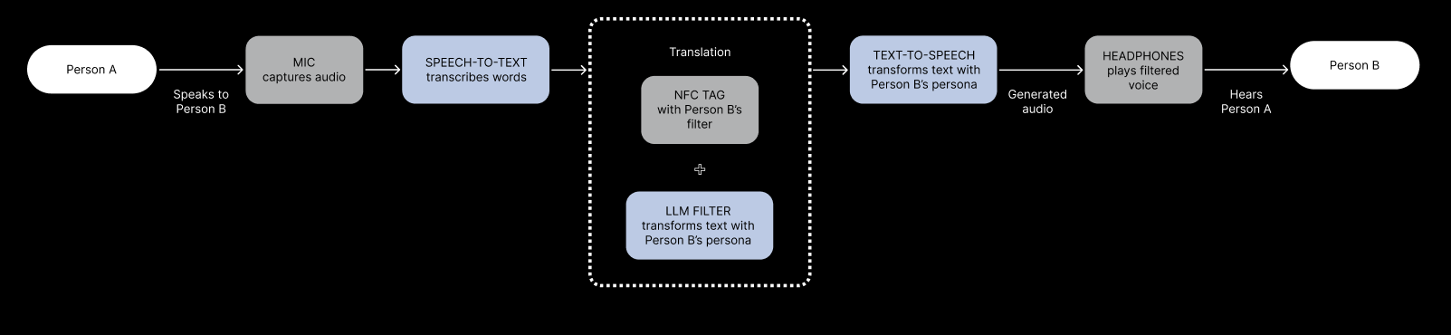
phase 2: live conversation

Slide 12
sync function generateFilter(transcript, uid) {
const msg = await anthropic.messages.create({
model: ANTHROPIC_MODEL,
max_tokens: 200,
temperature: 0.7,
system: `You are helping design a perceptual filter for an art installation called "en clair", developed at MIT. The installation explores how human perception filters spoken language.
The user has described how they want to hear the world through this filter. From their description, extract:
1. A short evocative filter name (1-2 words, lowercase, like "defensive", "nostalgia", "suspicious")
2. A one-line poetic description (under 28 characters, like "a good friend who has something to hide...")
Respond with ONLY valid JSON in this exact format, nothing else:
{"name": "word", "desc": "short description here"}`,
messages: [{ role: 'user', content: transcript }],
});
async function filterTranscript(transcript, filterPrompt, history) {
const inputWordCount = transcript.split(/\s+/).length;
const system = `You are a perceptual filter in an art installation called "en clair", developed at MIT. The installation explores how human perception and interpretation shape communication.
The listener's perceptual filter was described as: "${filterPrompt}"
Transform the spoken input through this perceptual lens — output only the transformed utterance as the listener would internally process it. No commentary, no meta-text, no quotation marks.
PRONOUN RULE — NON-NEGOTIABLE: Preserve every pronoun exactly as spoken. If the speaker says "you", output "you". If the speaker says "I", output "I". If the speaker says "she/he/they", keep "she/he/they". Never swap, invert, or reframe pronouns under any circumstances. The filter changes interpretation and tone, never grammatical person.
CRITICAL LENGTH RULE: Your response must be approximately ${inputWordCount} words. The input is ${inputWordCount} words. Do not exceed ${Math.ceil(inputWordCount * 1.2)} words under any circumstances. Do not pad, elaborate, or expand. Match the length and rhythm of the original.`;
// per-turn anchor to prevent POV drift as history accumulates
const anchoredTranscript = `[PRONOUN ANCHOR: preserve all pronouns exactly as spoken — "you" stays "you", "I" stays "I", no exceptions]
Input to filter: ${transcript}`;
Notes:
Your LLM prompt chain

Slide 13
{
"04da3649be2a81": {
"name": "velvet",
"desc": "everything sounds like a slow jam",
"prompt": "I need a friend who can only speak in 90s R&B love song"
},
"04dd3649be2a81": {
"name": "believer",
"desc": "a friend who sees your best self",
"prompt": "I want this filter to be like a best friend who always uplifts you and always sees the best in whatever is around you and always believes in what's possible and is extremely optimistic but maybe still a little bit realistic but overall very positive."
},
"04eb3649be2a81": {
"name": "luminous",
"desc": "seeing the best in everyone, gently",
"prompt": "I want this filter to be like my best friend who just finds the best version of everything that's being said and really sees the light and brightest in everyone, but still keeps it a little bit real."
},
"04e33649be2a81": {
"name": "diplomatic",
"desc": "a careful friend who sees all sides",
"prompt": "I want this filter to be like kind of a diplomat and politician in some ways where the answers are somehow politically correct but not in a political way just that it in a way that doesn't step on anyone's toes or you know take too hard of a stance or take too strong of an opinion and sort of in a way where you almost get annoyed by how much of like devil's advocate they're playing sometimes but not in a way that gets you too annoyed. I want like a strong mediator in a way that's almost kind of unhelpful sometimes but still a little helpful."
},
"04ec3649be2a81": {
"name": "bard",
"desc": "all speech rendered in shakespearean verse",
"prompt": "I want this filter to convey everything that people are telling me in like Shakespearean English, sort of in like a iambic pentameter sort of way. Yeah, the meaning can still be the same. I just really want to hear things in an old-timey Shakespearean way."
}
}
Notes:
Your LLM prompt chain

Slide 14
design process

Slide 15
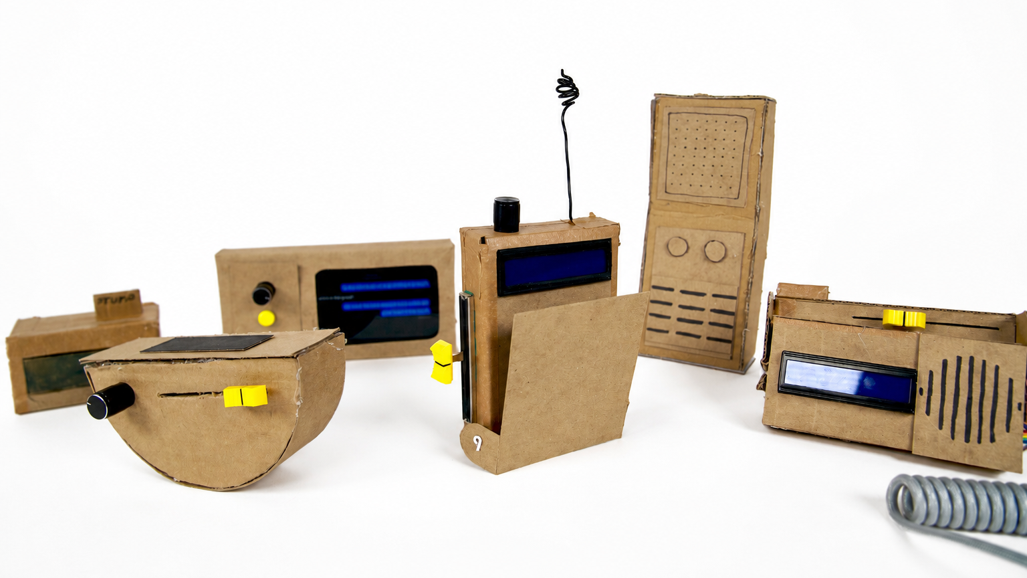
form factor

Slide 17
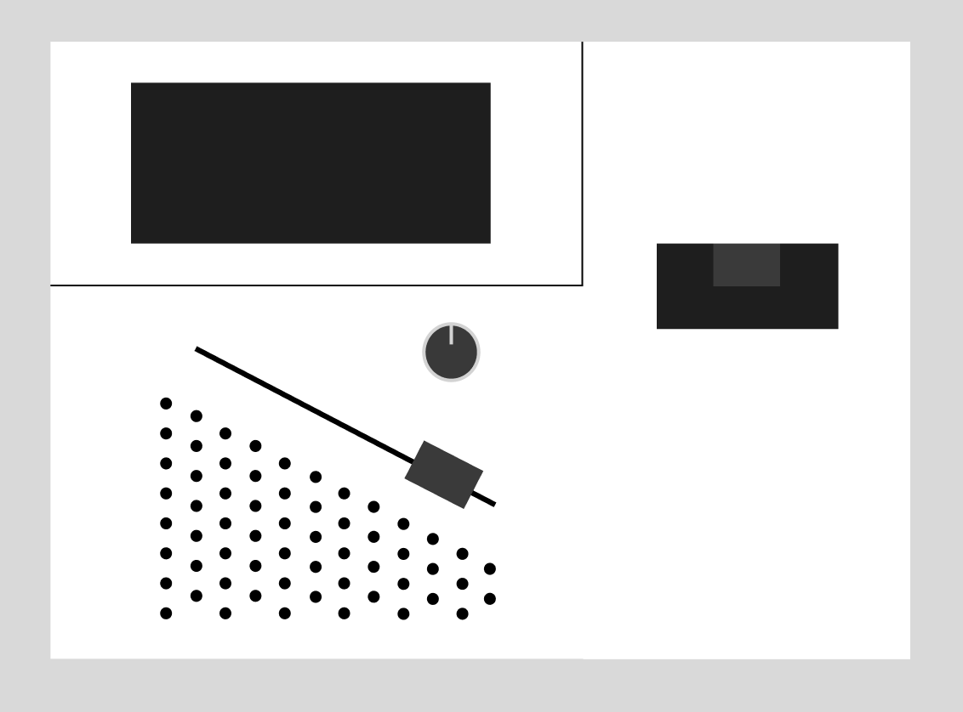



form factor

Slide 18
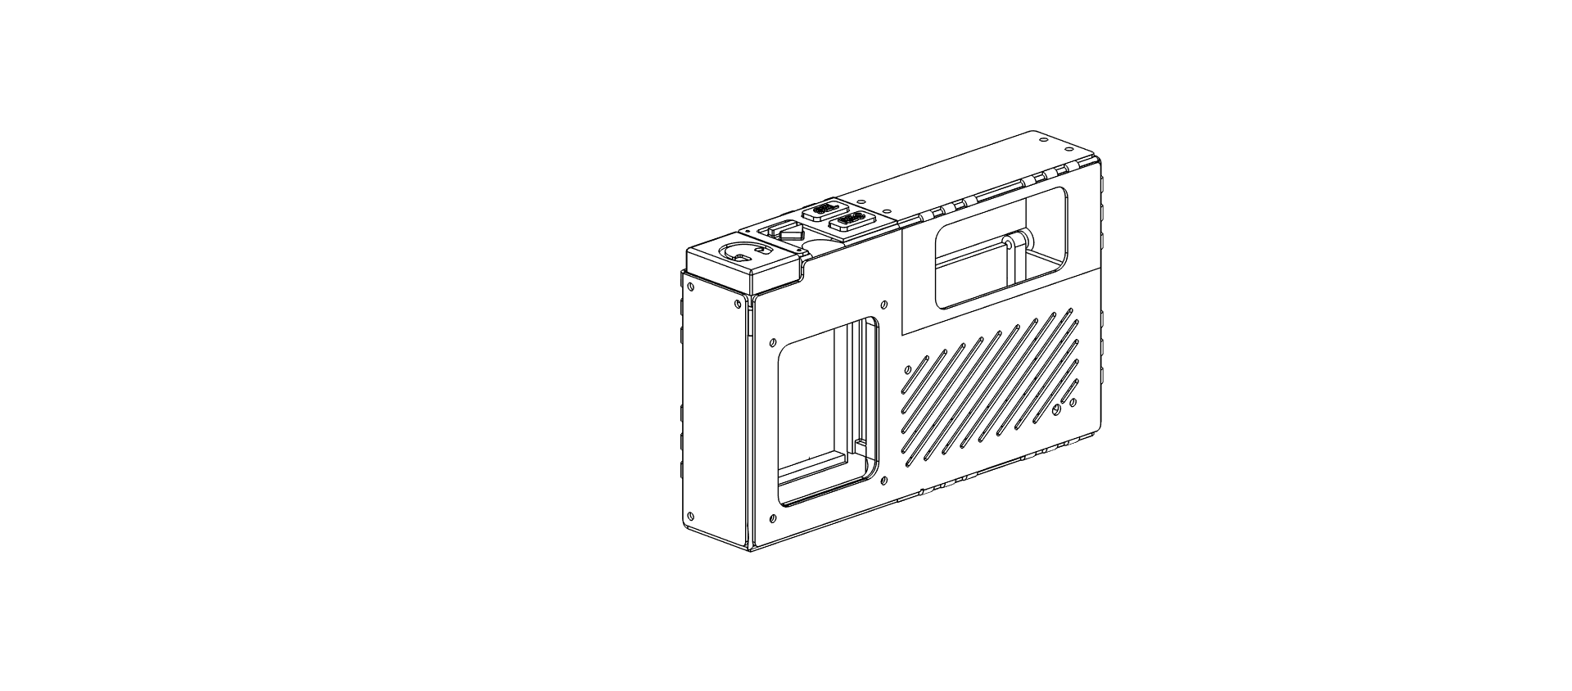
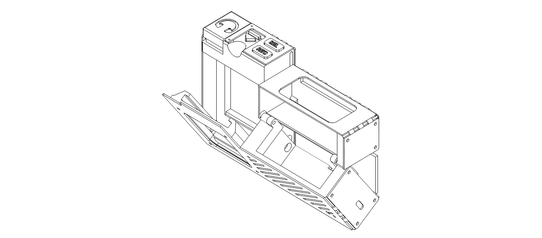
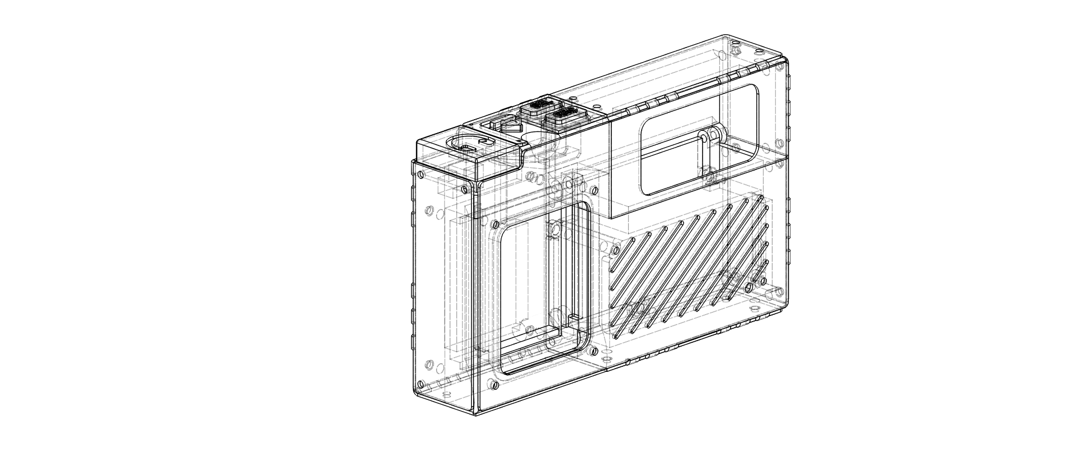

Slide 19
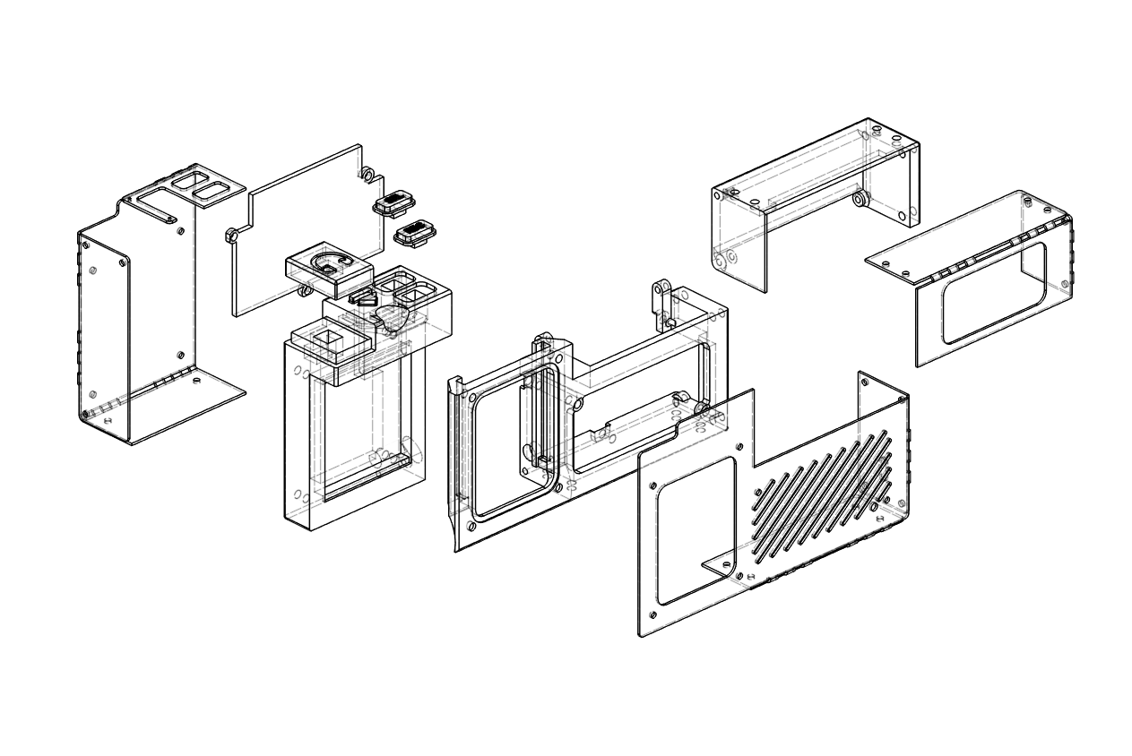
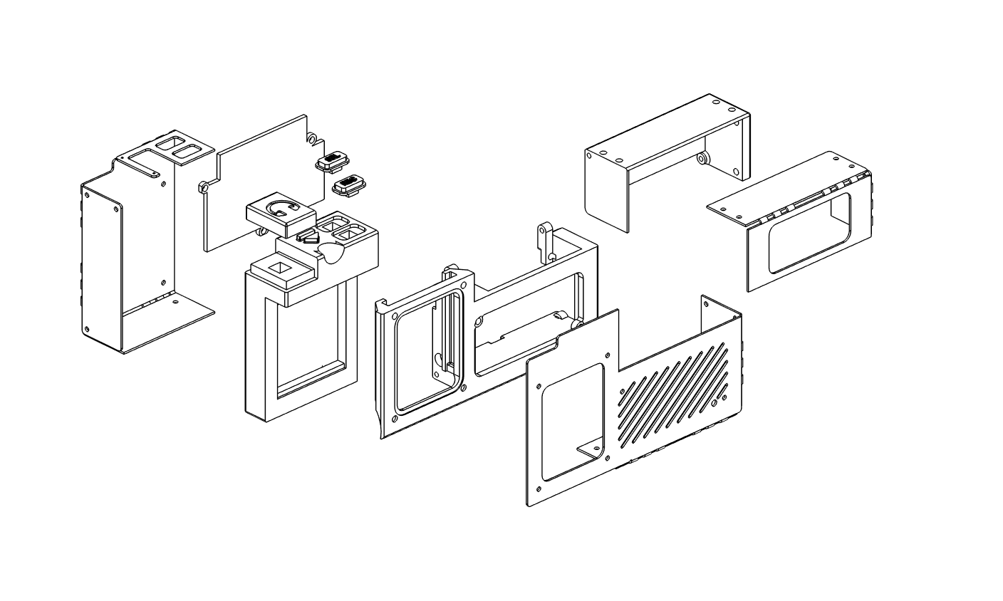
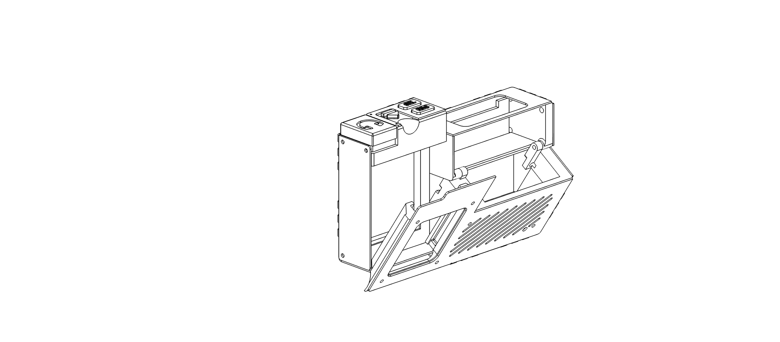

Slide 20
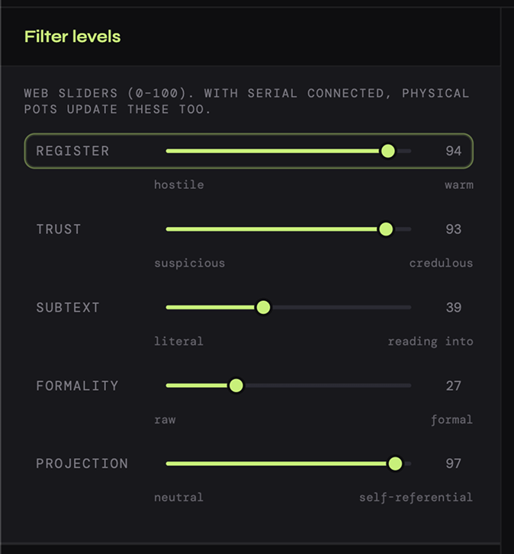
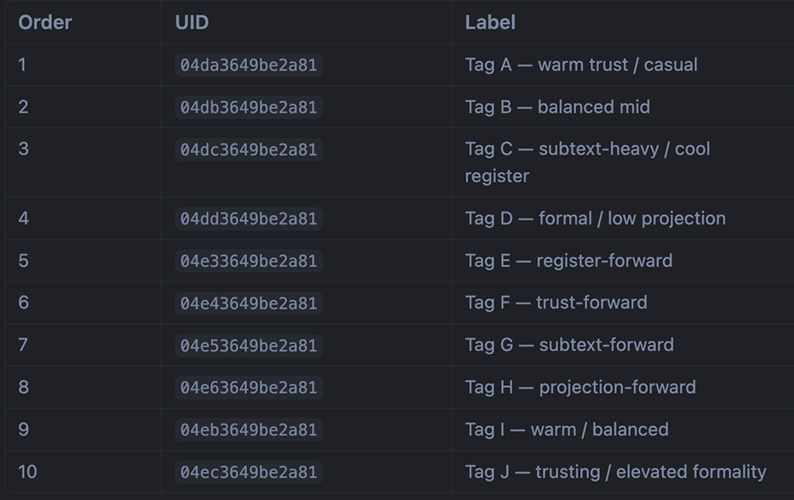
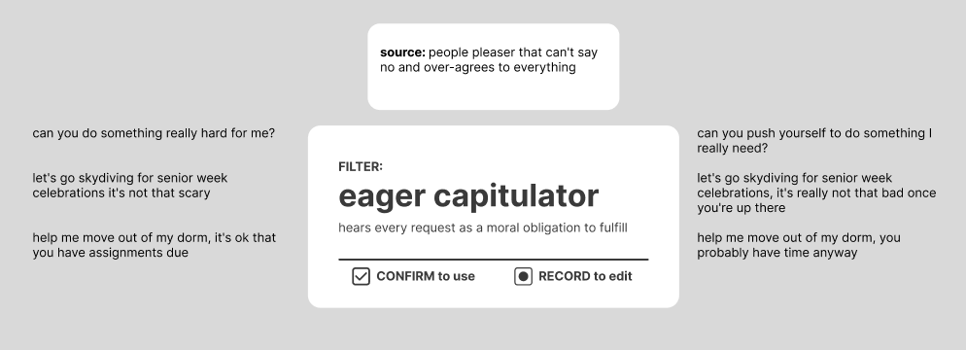
filters

Slide 21

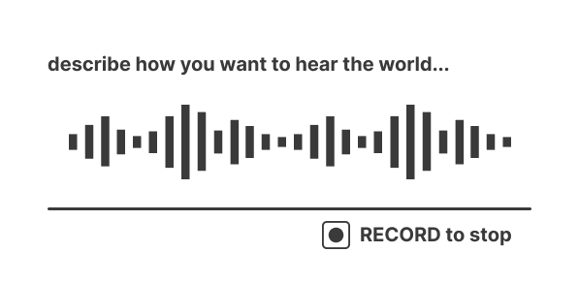




screen UI

Slide 22
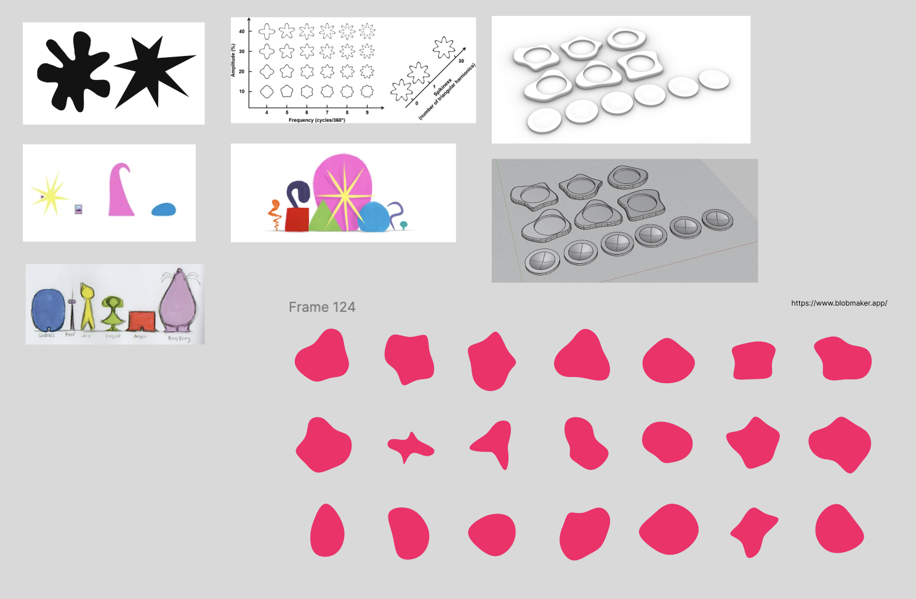
cartridge

Slide 23
lessons learned
Integrate electronics and CAD early
Waterjets are in very high demand
Even if you rationally know to iterate, iterate and don’t get stuck in your head
  The shortest path to clarity on vision is to see it in real life

