Slide 1
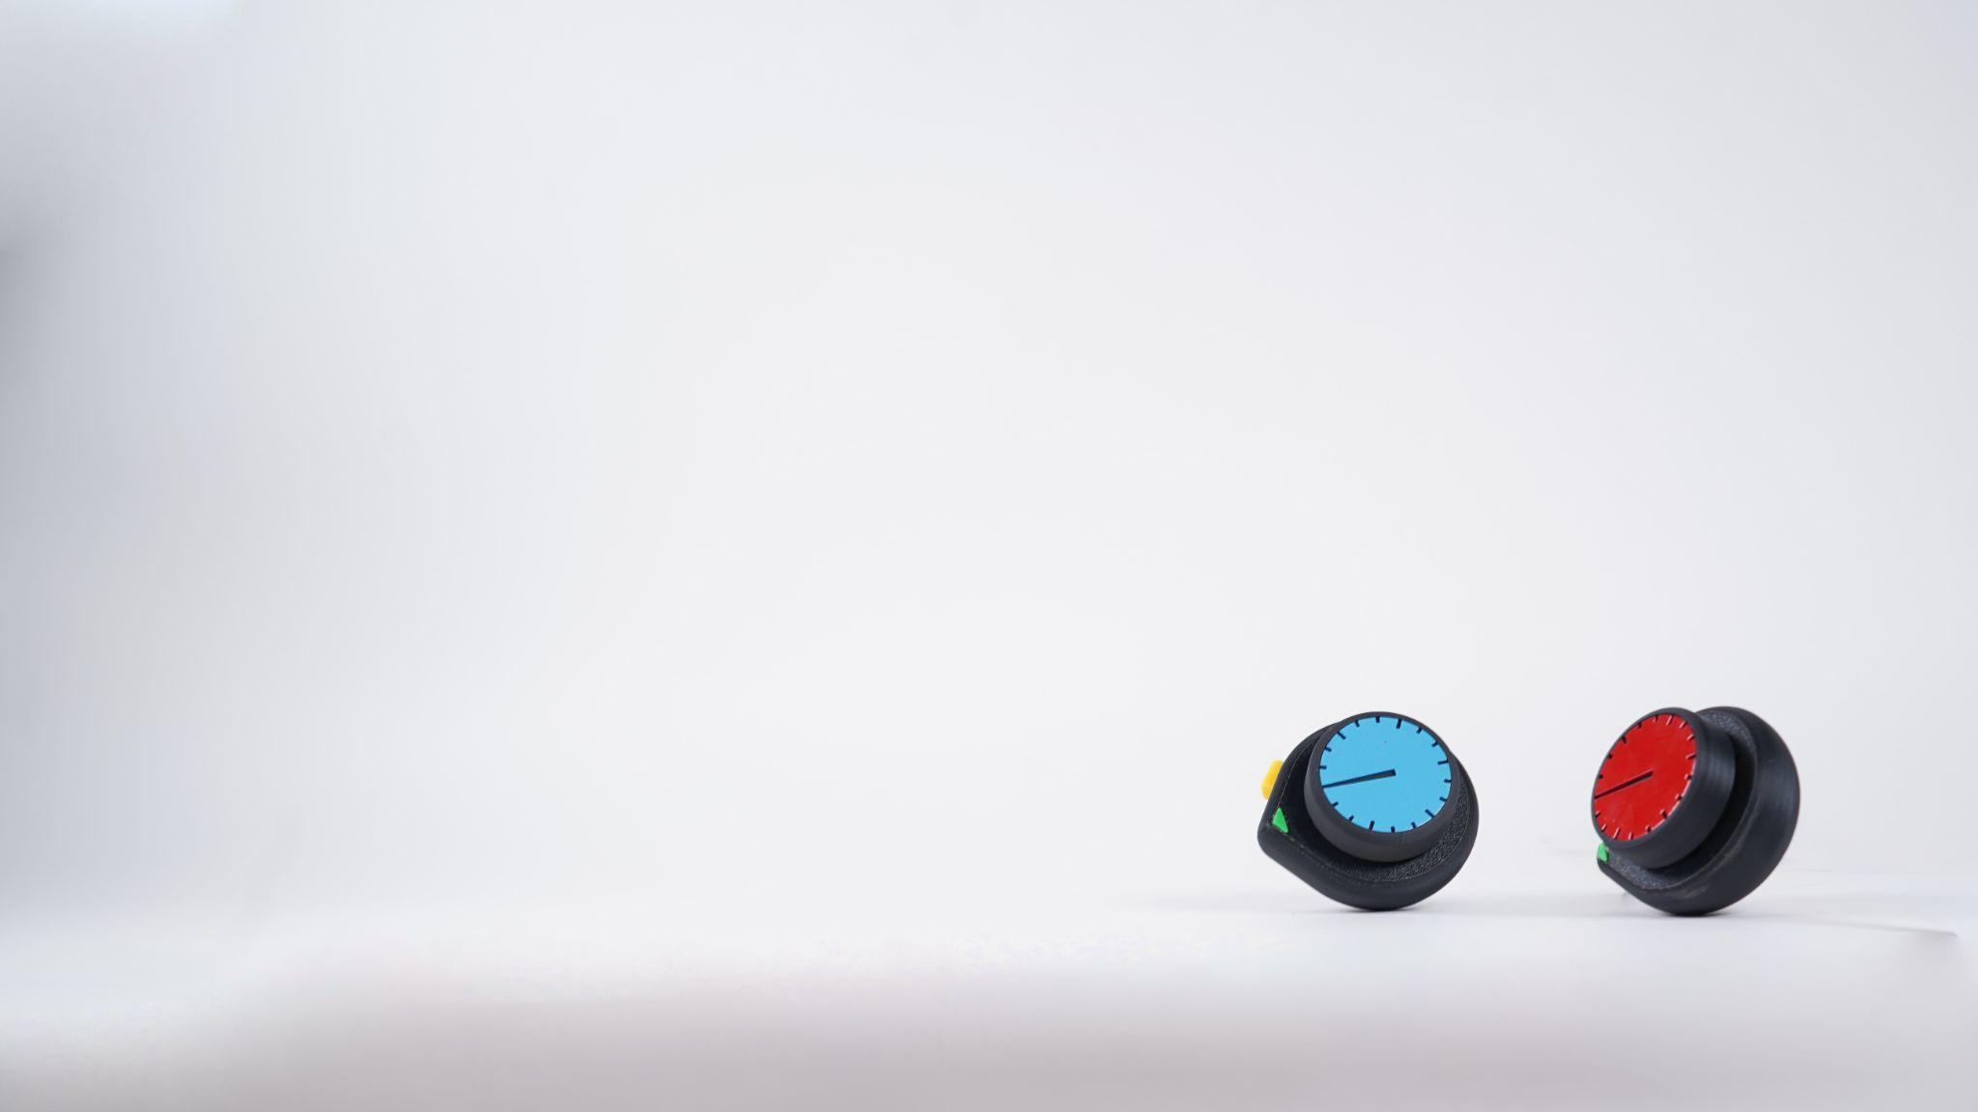

Jonny Cohen
Elaine Liu
Milin Tunsiricharoengul

Slide 2
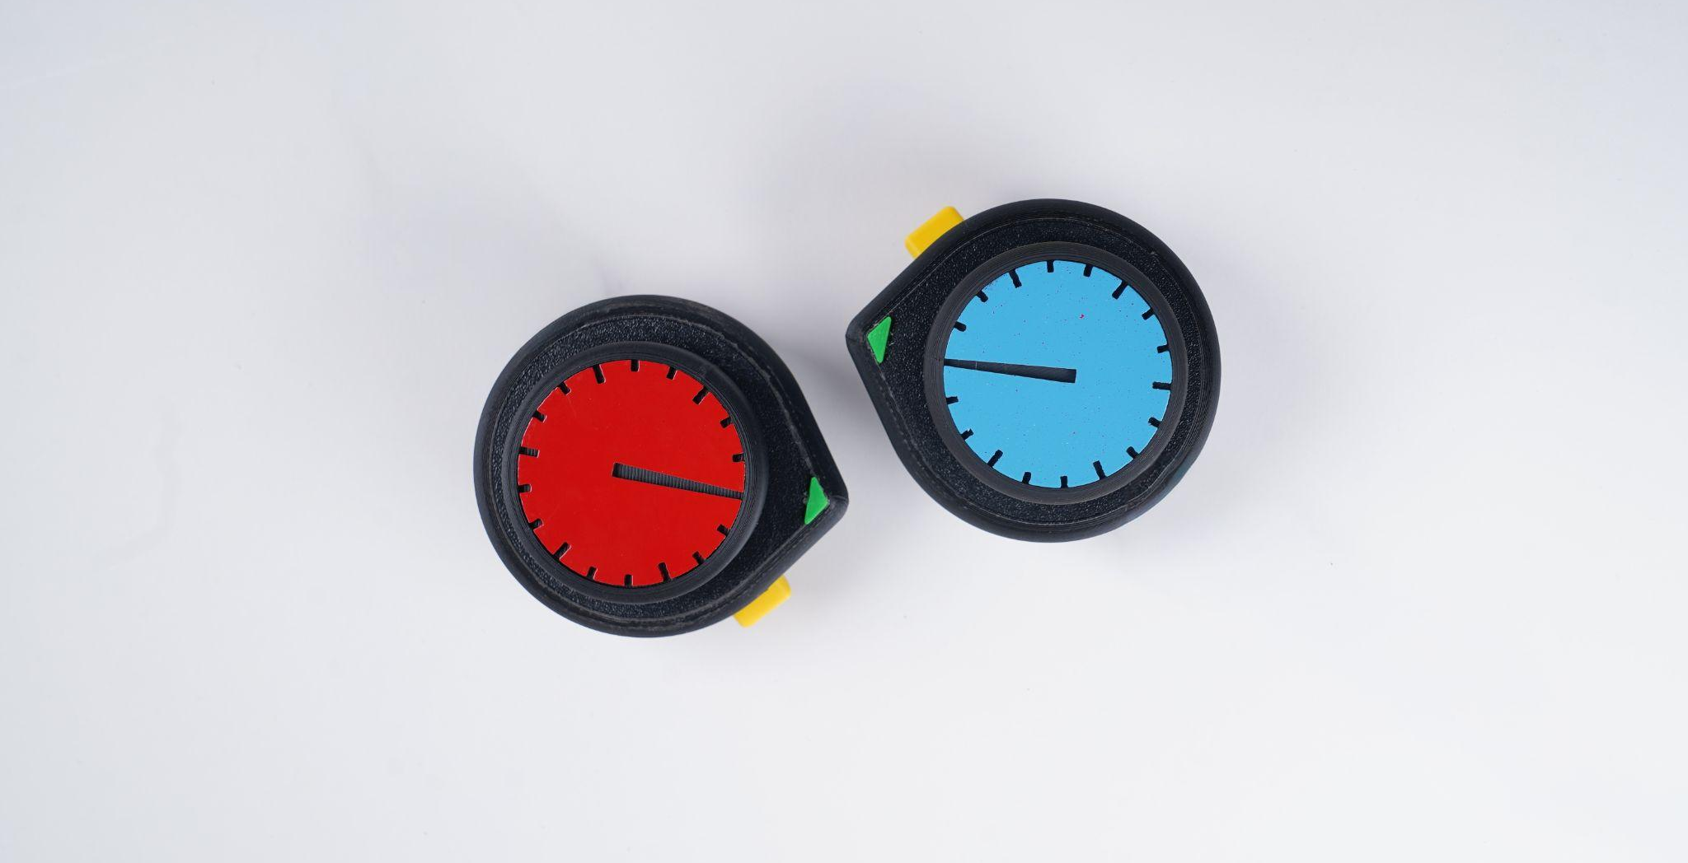
f1d distills the world of Formula racing
to what really matters—who's fastest.
Control your speed to stay on the track,
avoid the obstacles, and don't let your opponents hit you.
Notes:
Short paragraph describing your project.
Keep this simple and direct. It should answer:
"what? how? Why?"
F-1D is a competitive game that condenses the world of formula racing into its simplest find out who is the fastest around the track.
Players control the speed of their car to win, all while trying to knock opponents off and avoiding obstacles and sliding off track.

Slide 3
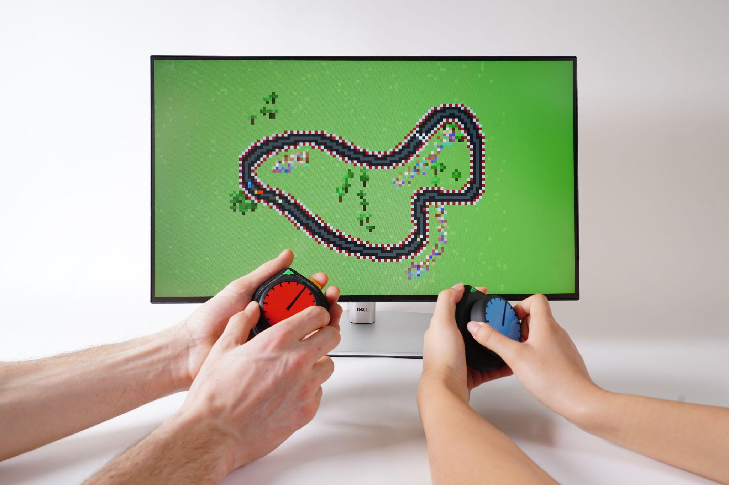
Notes:
Two players with main screen in middle

Slide 4
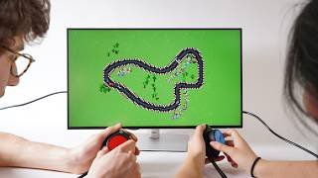
Notes:
Video of your project in action.
Keep your video simple, no need for titles, fancy transition animations or effects. Instead focus on shooting it against a plain background, well lit, and that highlights the full interaction. Make sure your camera is on a tripod, and cables are not visible.

Slide 5
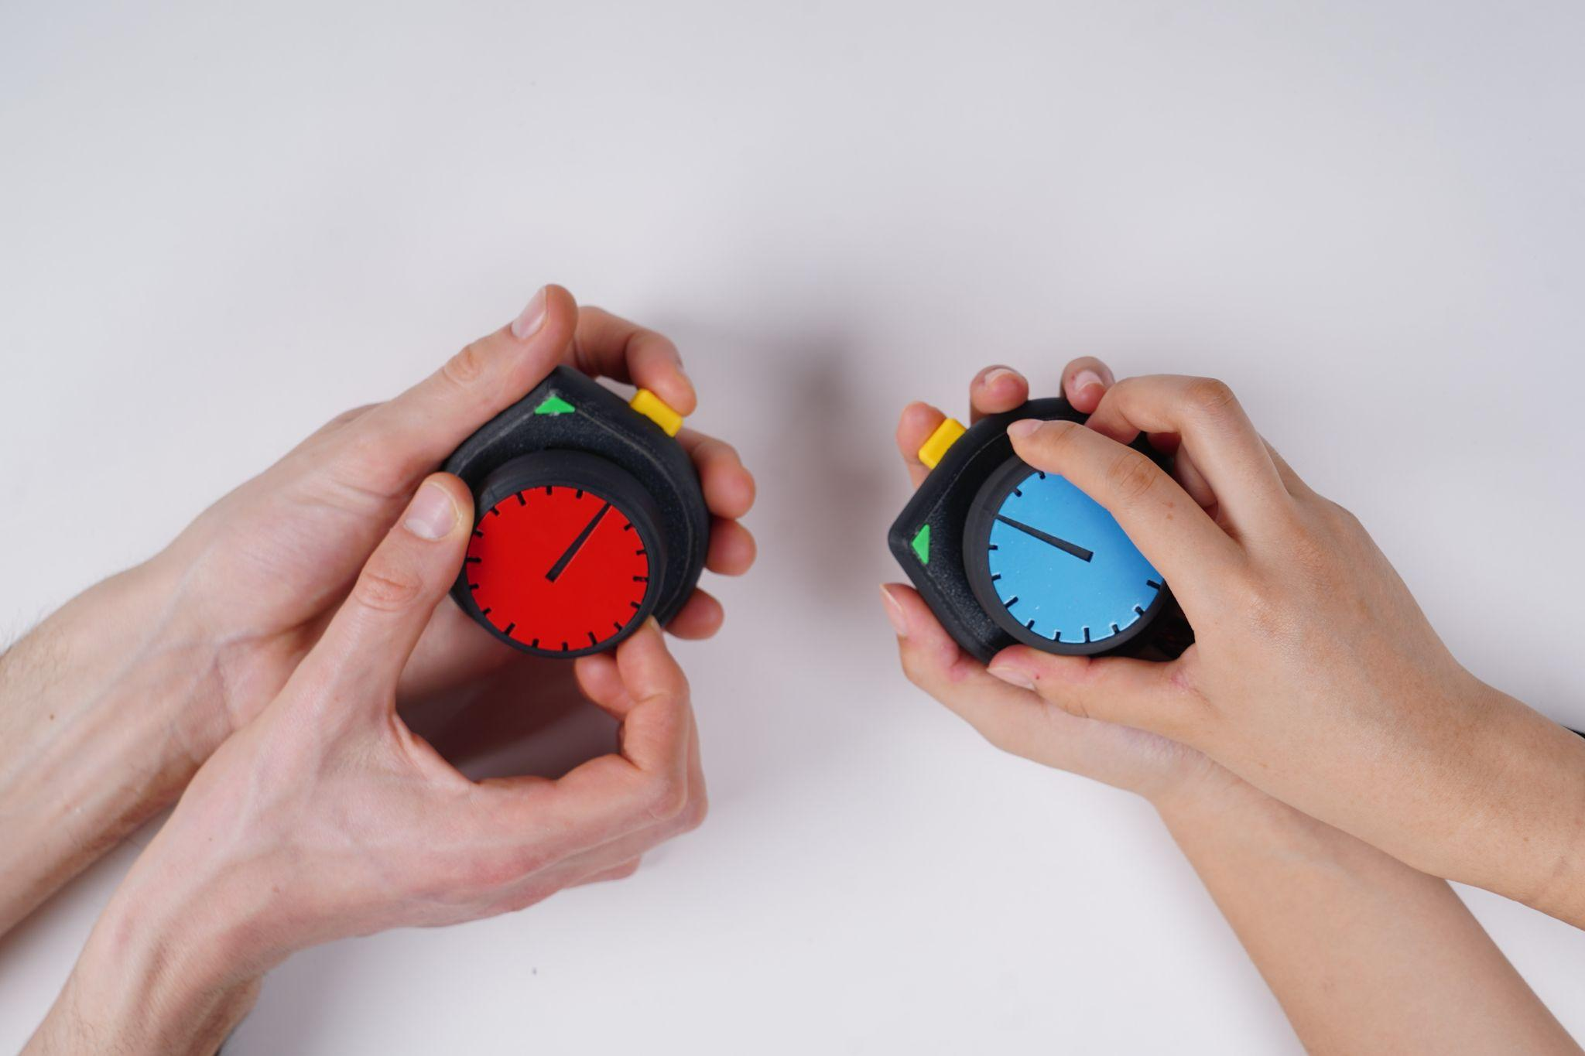

Slide 6
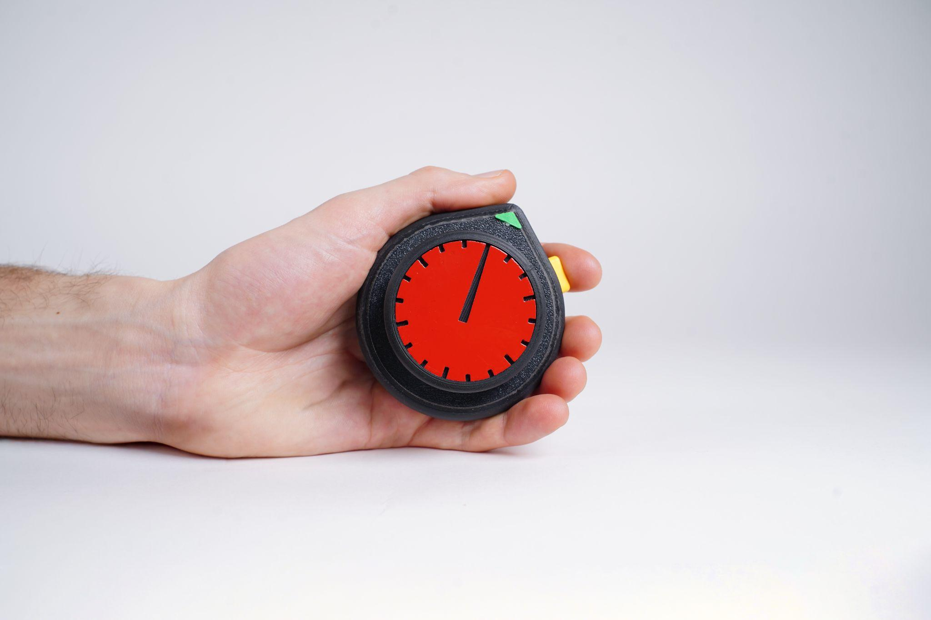

Slide 7
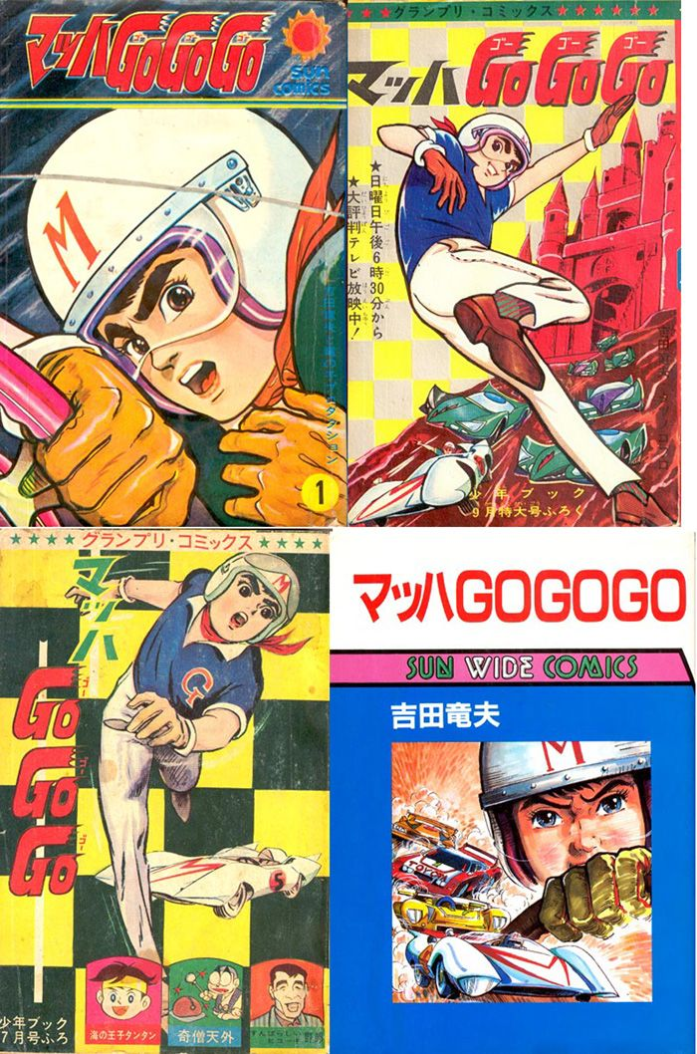
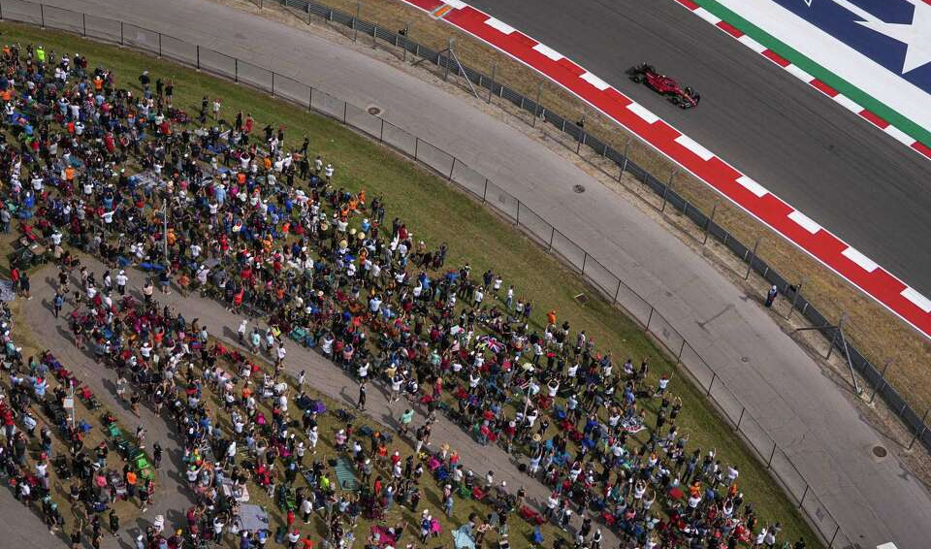
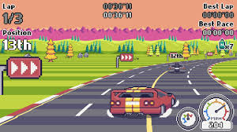
If a circle is “1D,” could a curved
loop also be 1D?
How can we give a curved loop a 1D interaction?
Could we make a simple racing game that maintained the engagement of a complex racing game?
Notes:
Images of references, questions or context, that inspired your design.

Slide 8

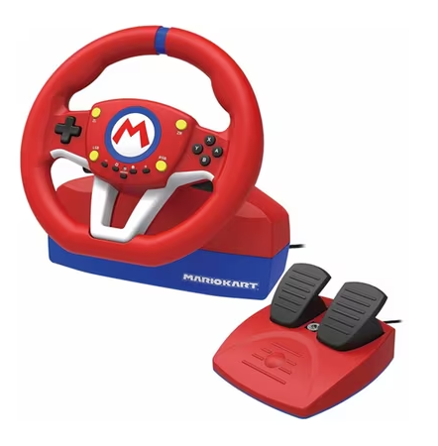
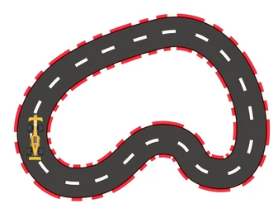
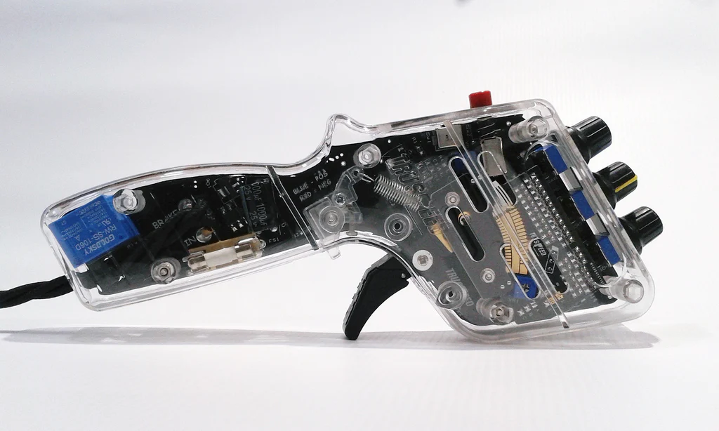
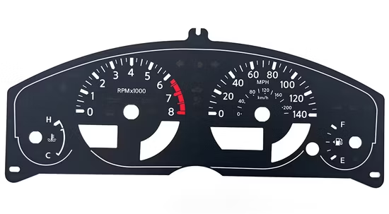
Controller Motivation
Notes:
Images of references, questions or context, that inspired your design.

Slide 9
Race
Player Finishes
Start
Generate New Track
Banana, Hit, or Overspeed
Crash
Notes:
State diagram of your project

Slide 10
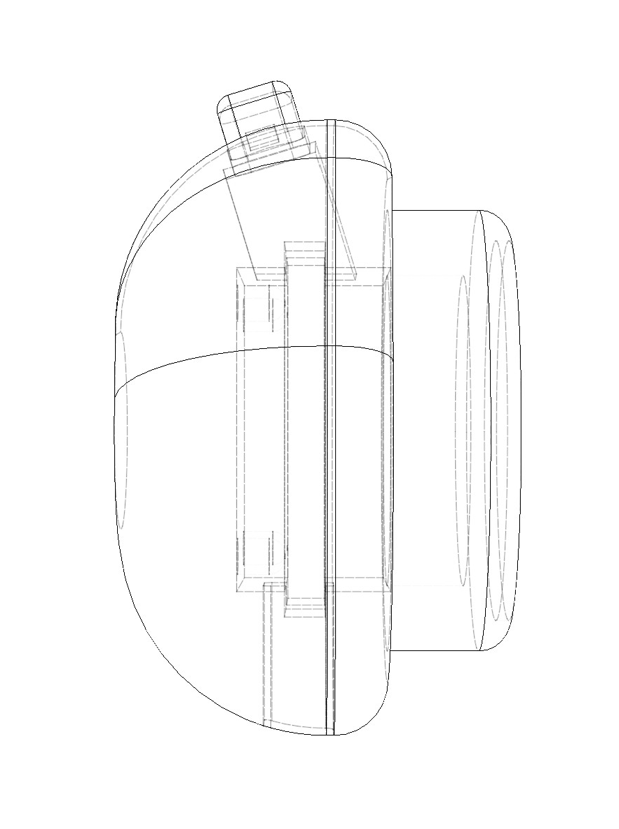
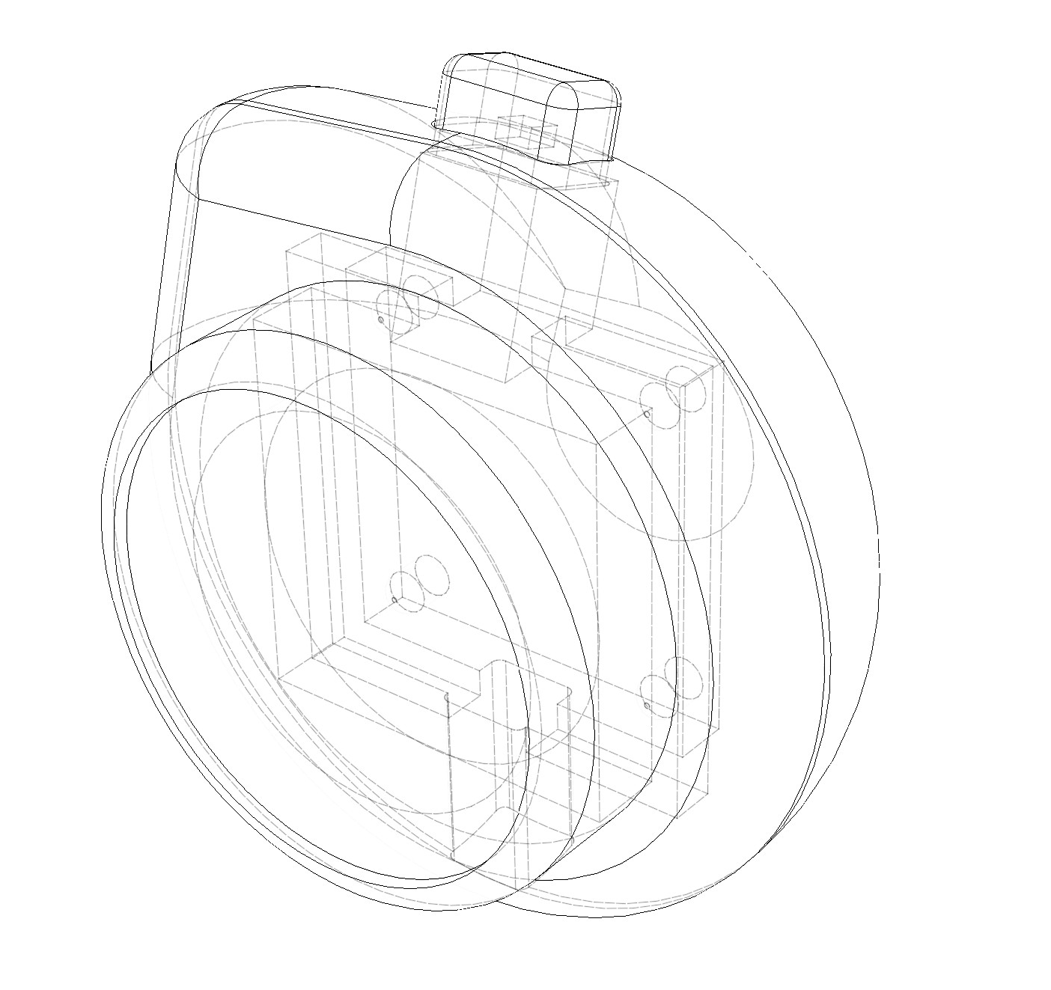
Technical Drawings

Slide 11
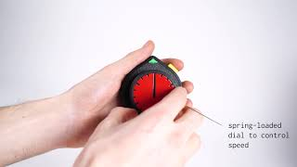
Interactions

Slide 12
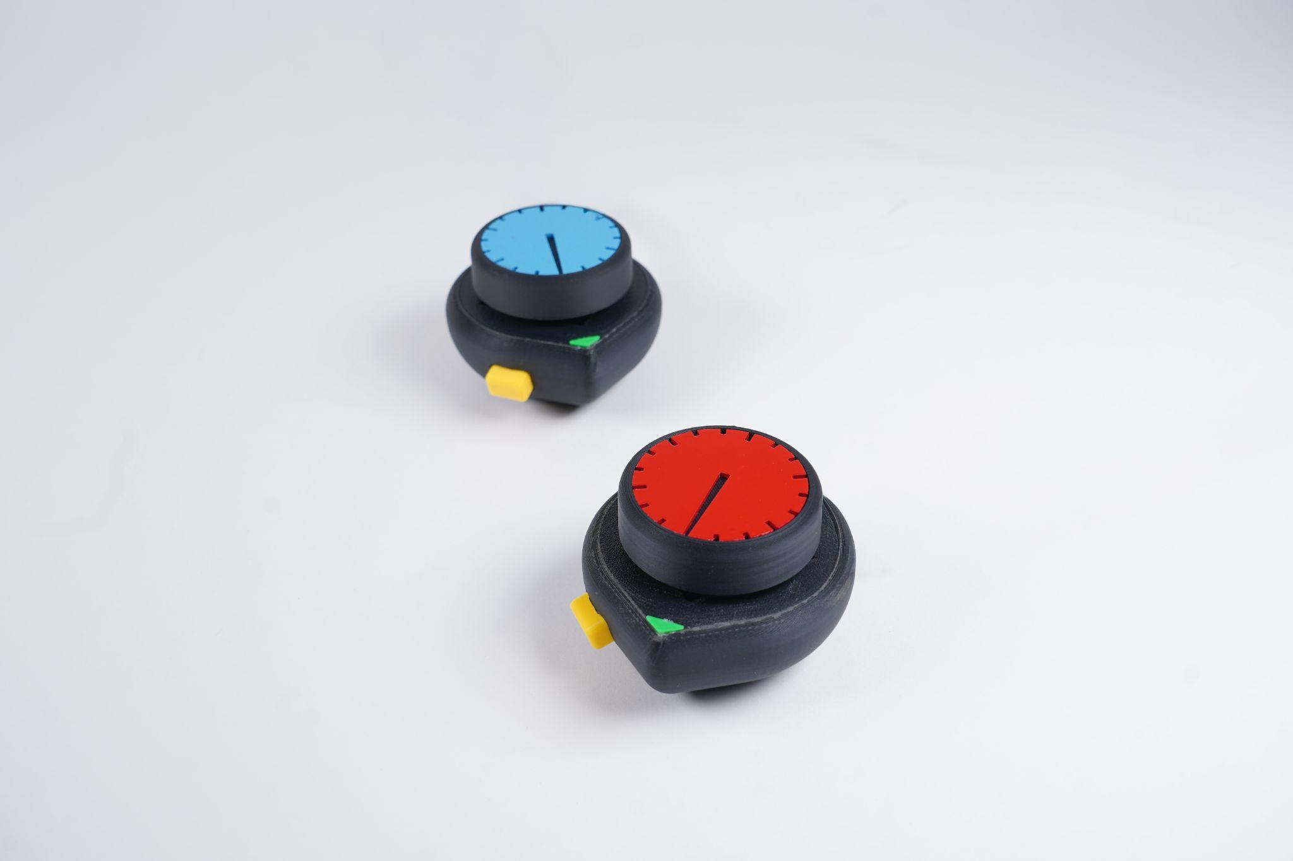
Design Process

Slide 13
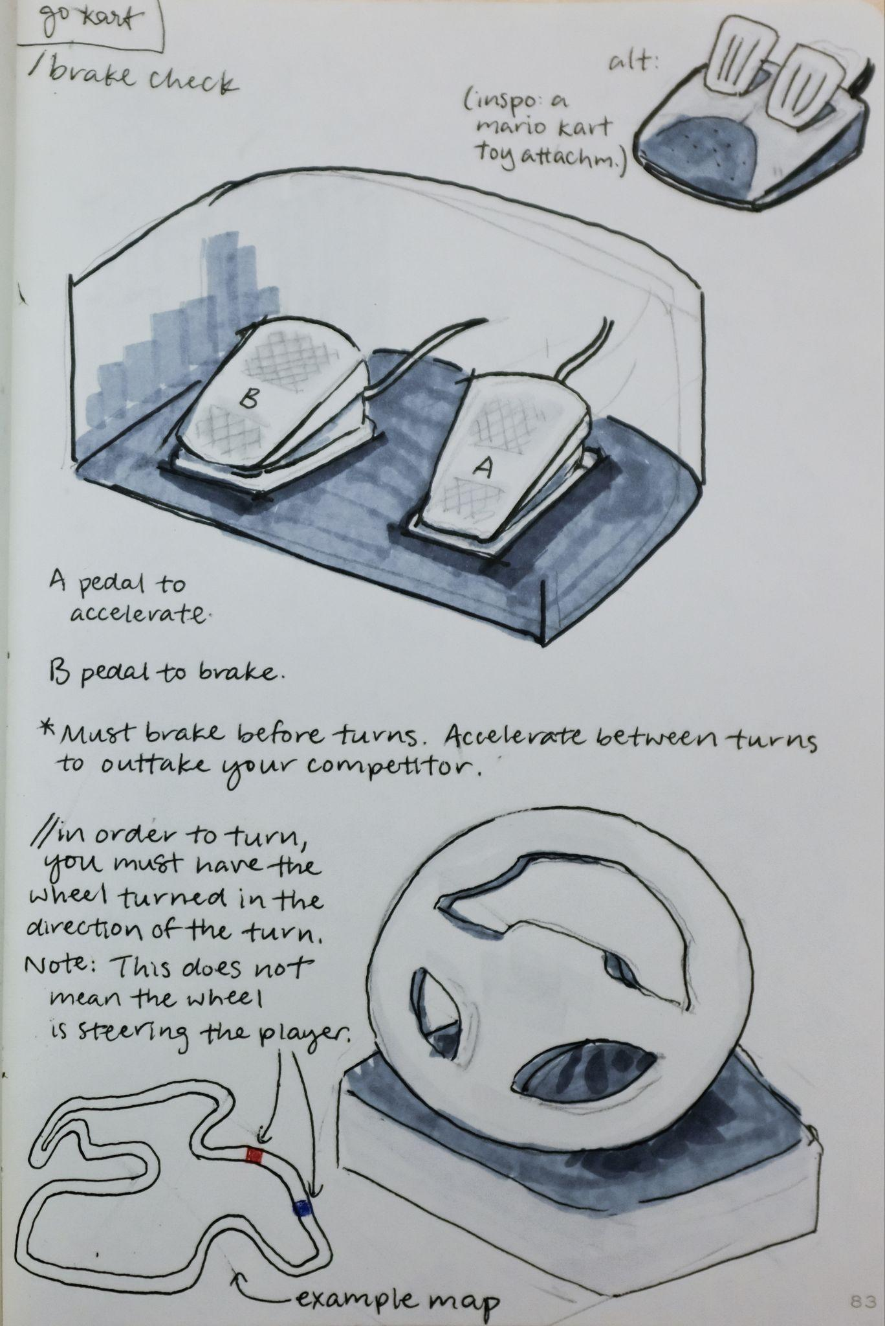
Potential interactions
Screamcar
Foot pedals
Button
Slider
Wheel

Slide 14
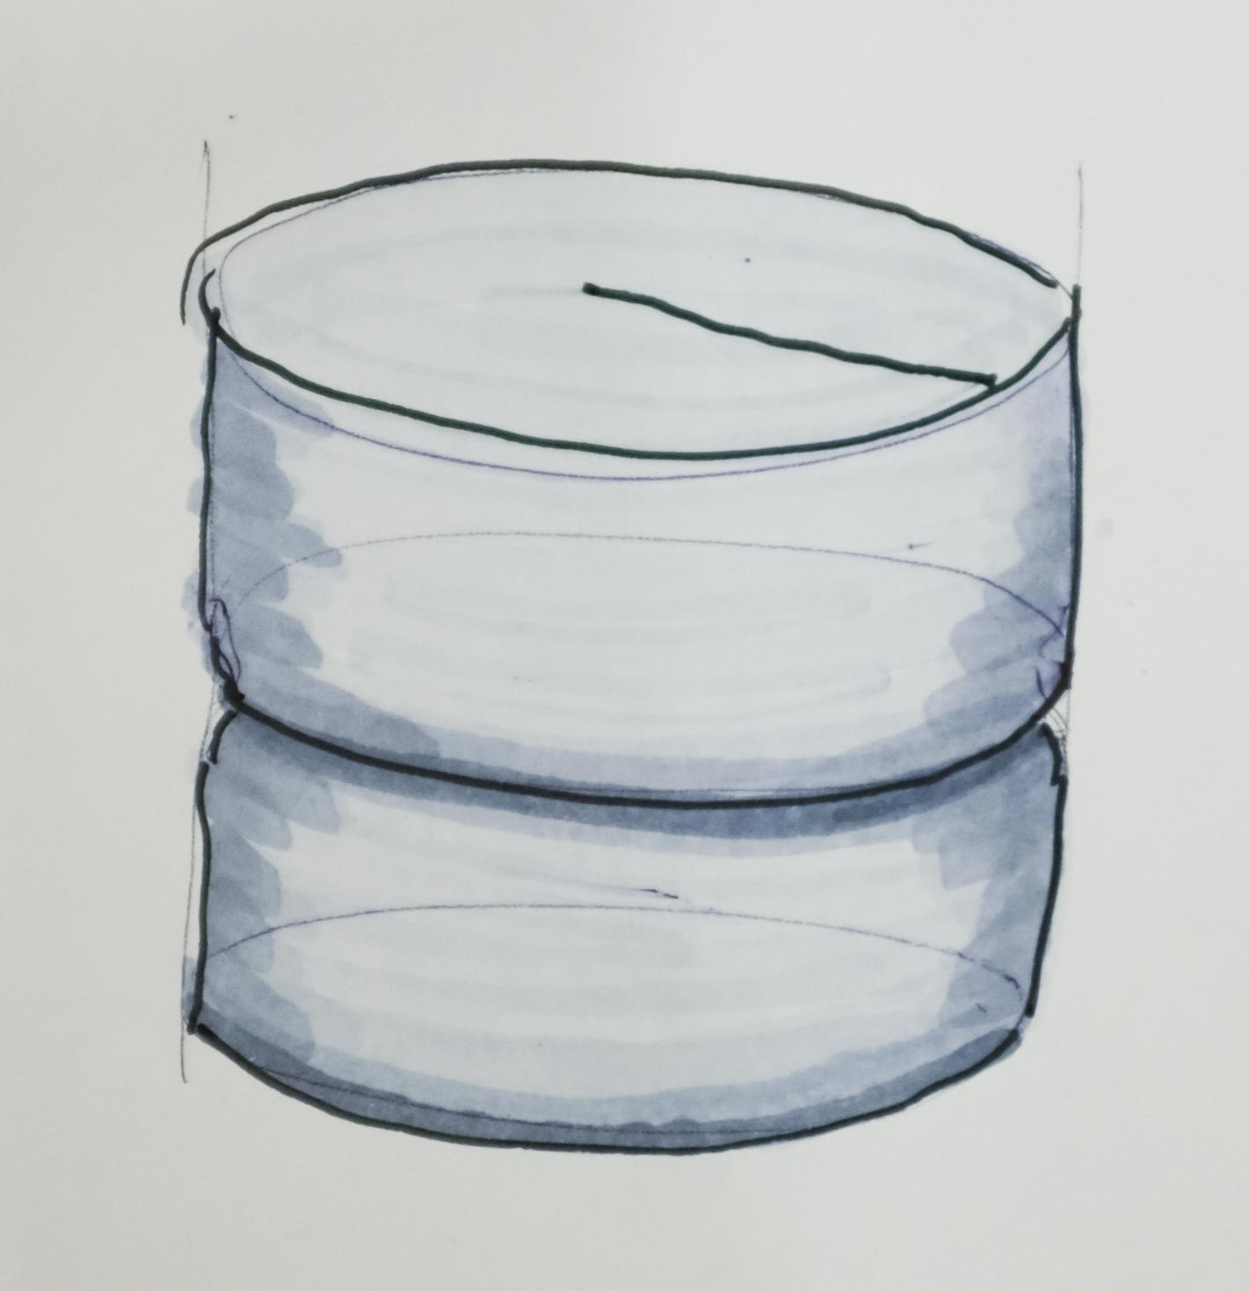
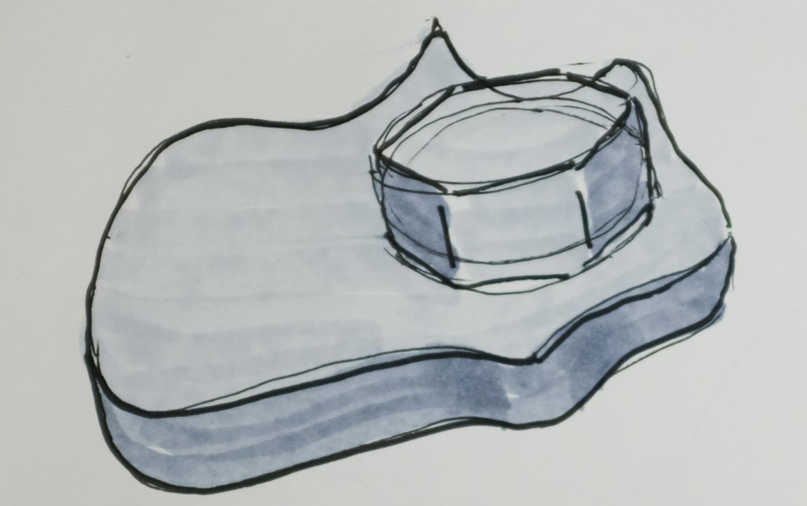
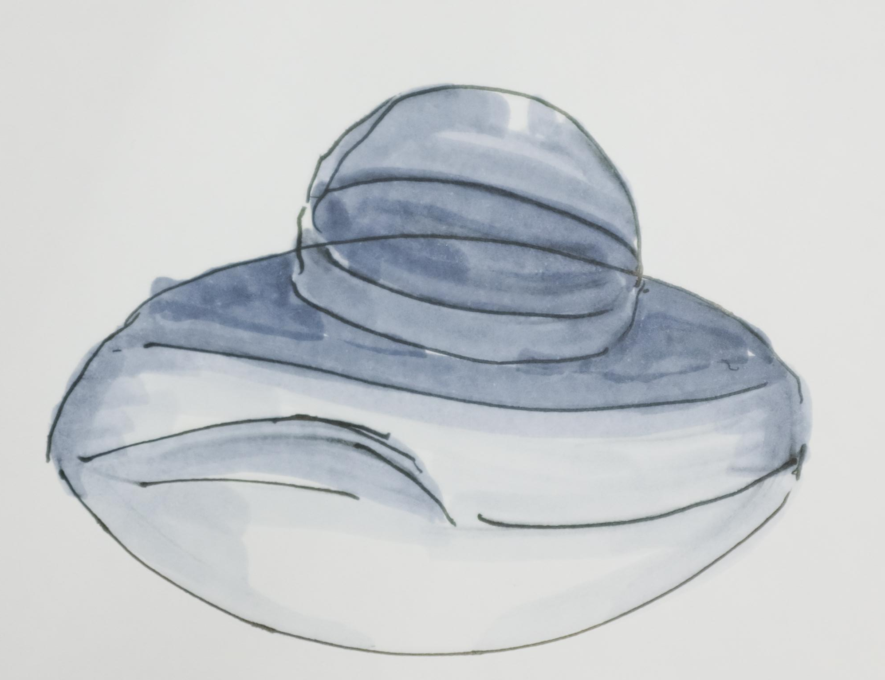
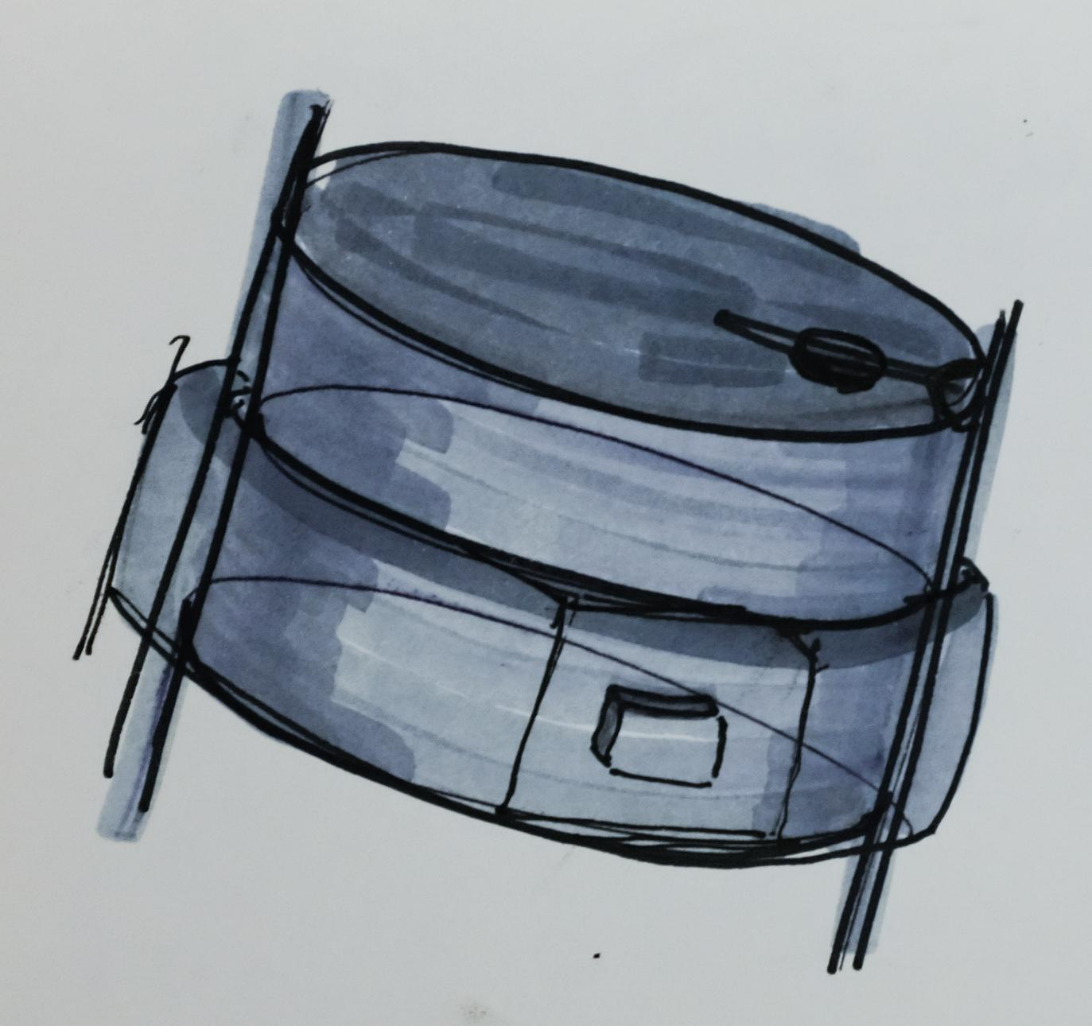
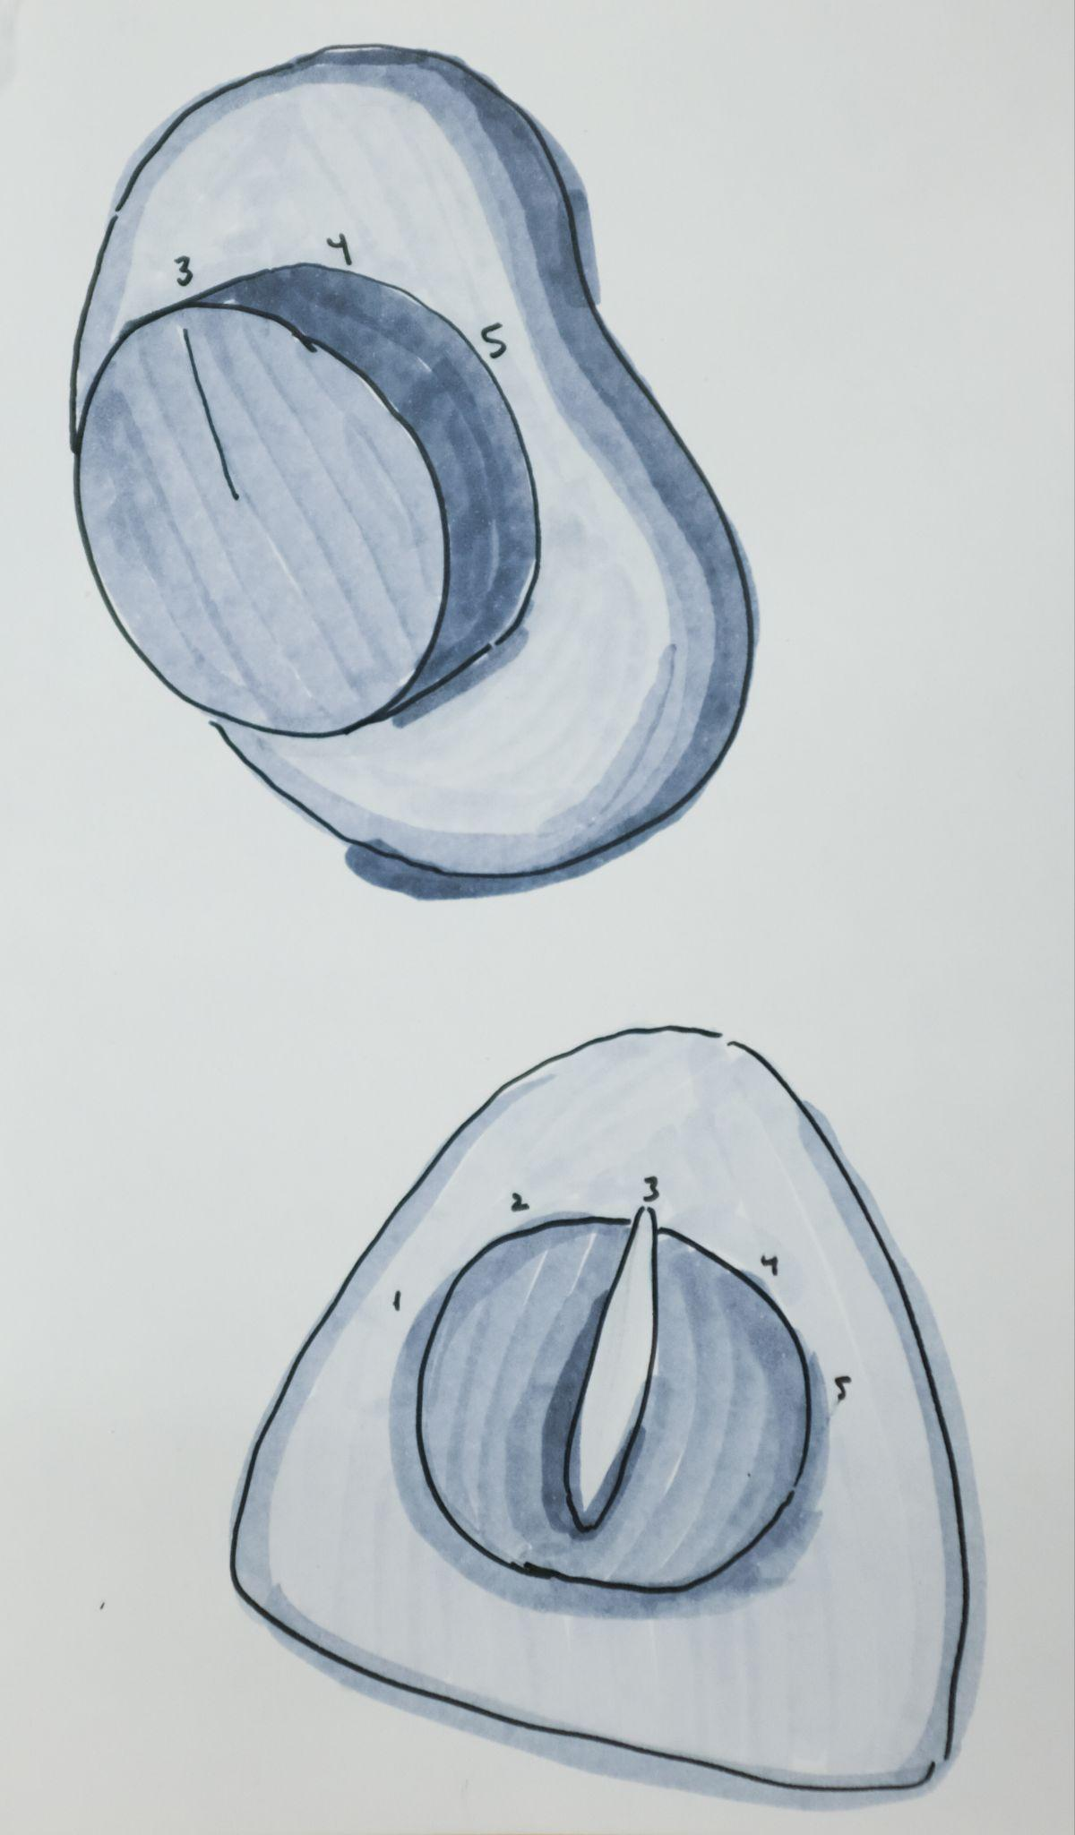

Slide 15
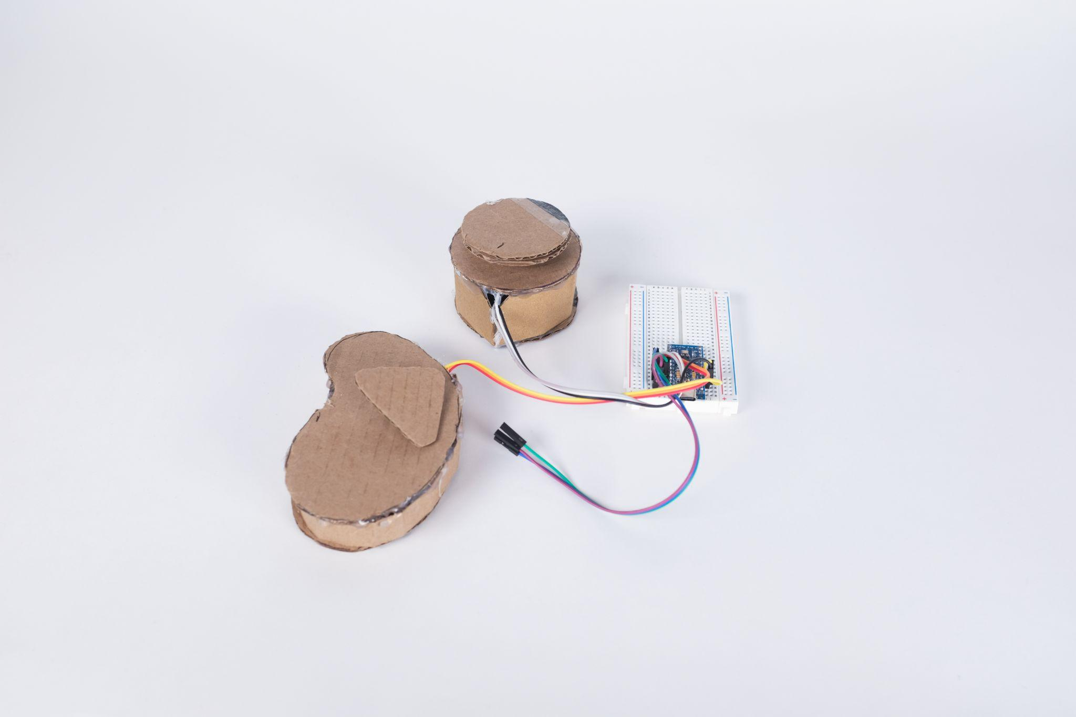

Slide 16
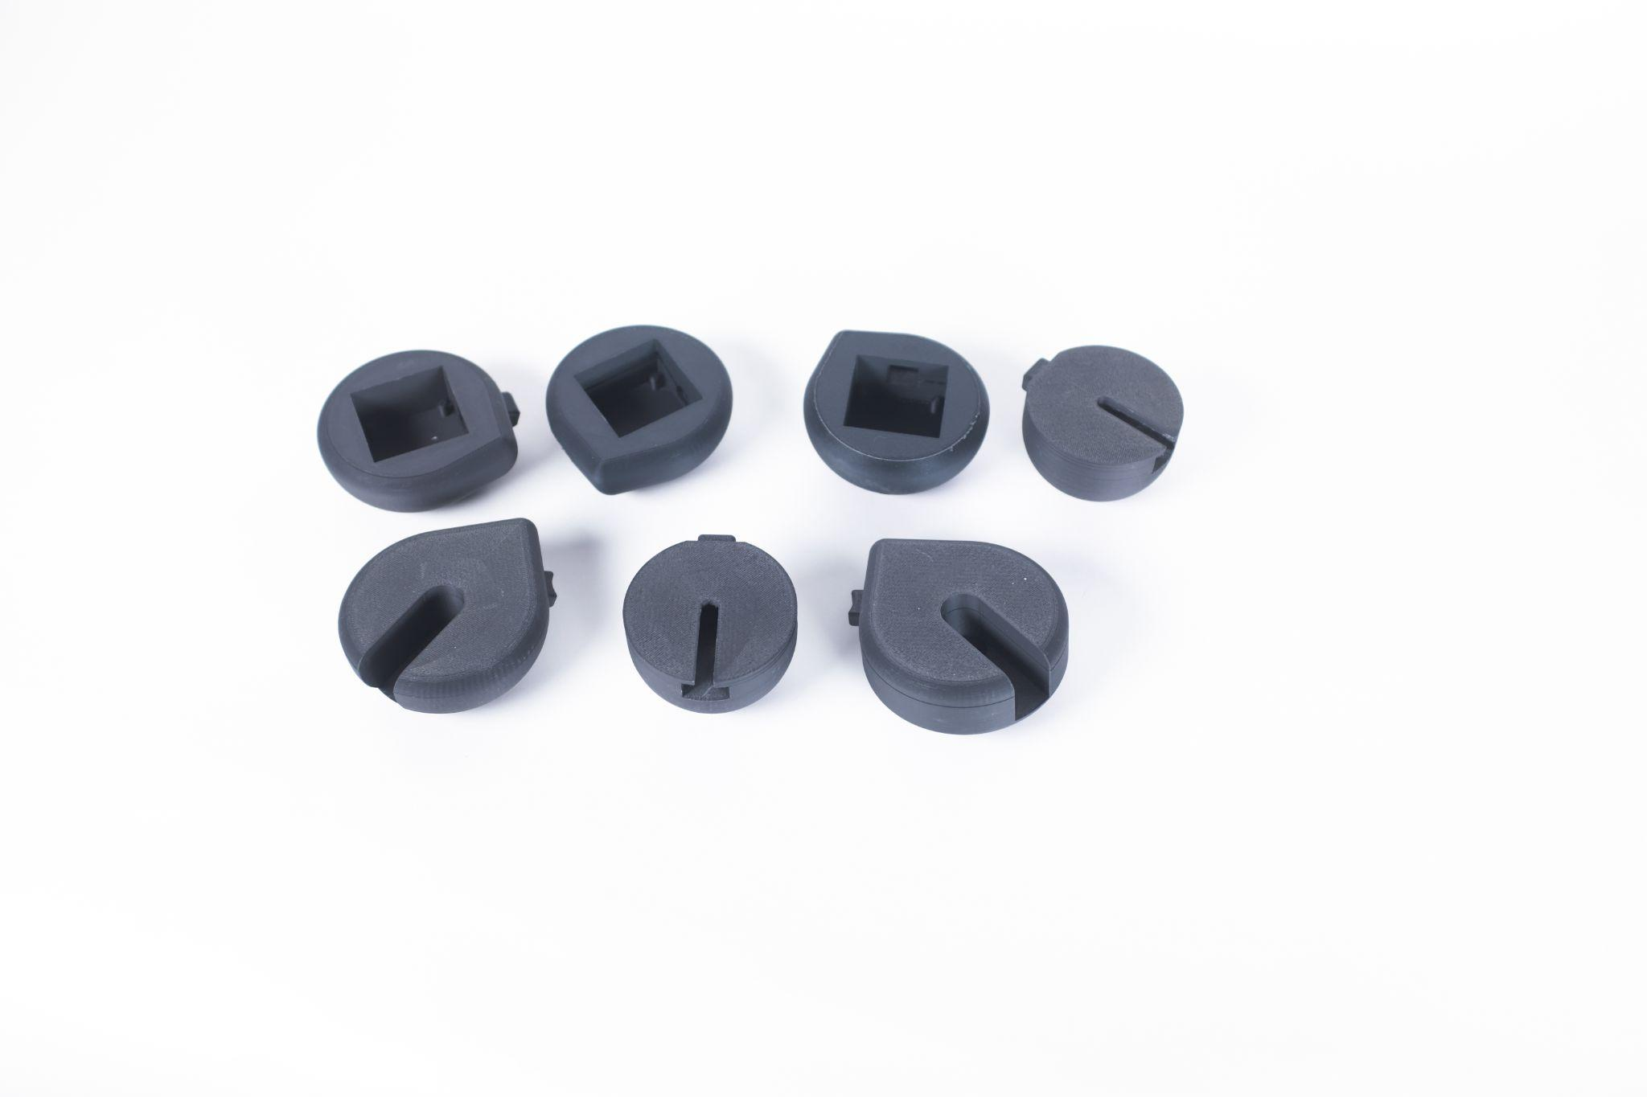

Slide 17
Lessons Learned
Prepare larger print designs earlier.
Test different interaction/controller mechanisms to see which is best to play with.
1D representations can easily be misinterpreted. Let people test the game.
Fine line between engaging and confusing haptics.

