Slide 1
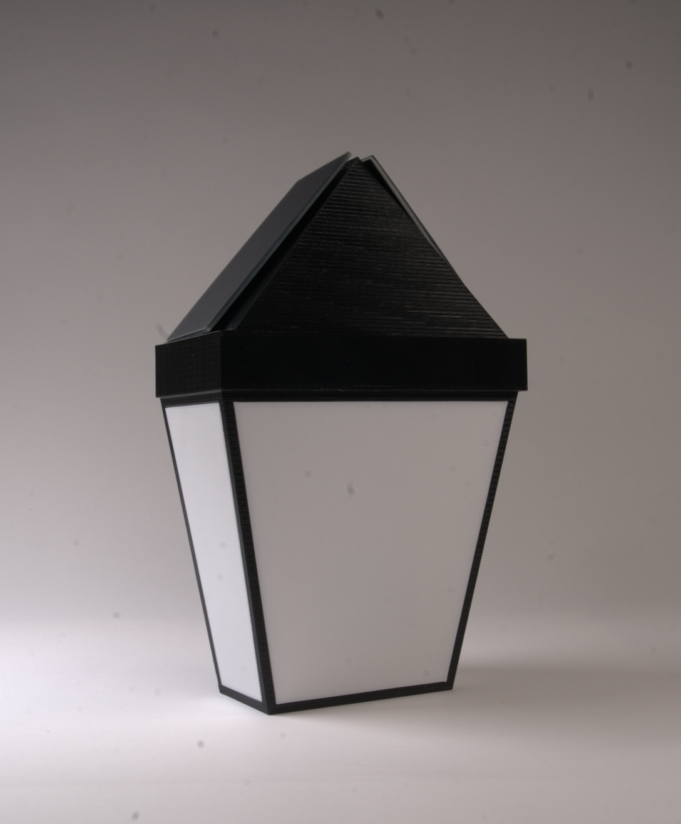
05.12.2026
CITY OF CAMBRIDGE - 6.900 ENGINEERING FOR IMPACT
velocity
(bike) (city)
A BOSTON BIKE LANE MONITOR
Notes:
Fernando

Slide 2
TABLE OF CONTENTS
TABLE OF CONTENTS
VELOCITY
1
2
3
6
8
9
Why Monitor Bike Lanes
How Velocity Works
Design
Specifications
Live Data
Thank You
Notes:
Fernando

Slide 3
WHO WE ARE
VELOCITY
WHY MONITOR BIKE LANES?
As bike lanes become more popular and
bike crashes more frequent,
bike safety is more critical than ever to understand.
But existing count data is fragmented and difficult to analyze.
We investigate the magnitude of separated bike lane usage in Cambridge to help inform safety implementation.
Notes:
From last class presentation:
Goals:
Device that can track bike lane usage
Can distinguish between bikes vs non-bikes
Detects direction
Minimum 1 year operation without servicing
Context given from their presentation:
Vehicle Trip Reduction Ordinance (1992)
⚫ Commitment to sustainable modes of transportation
⚫ Rise of bike lanes (5 foot unbuffered)
⚫ Growing interest in bike safety
⚫ Rise in bike crashes
⚫ Consider exposure to risk
⚫ Calculate crash rates
⚫ Cycling Safety Ordinance (2019)
⚫ Separated lanes must have buffers and posts
⚫ 25 miles of bike lanes by November 2026
⚫ Continued interest in bike safety
⚫ Some skepticism on the level of bike use
Elaine

Slide 4
SYSTEM OVERVIEW
HOW VELOCITY WORKS
VELOCITY
Pole-mounted device that uses radar to bi-directionally count bikes and communicate with one another via long range wireless radio.
Counts gets collected, processed, and posted to a server
Data is collected at all times except at night (1:00 am to 6:00 am) and posted every 30 minutes
Notes:
Maggie
Samvit
Jack

Slide 5
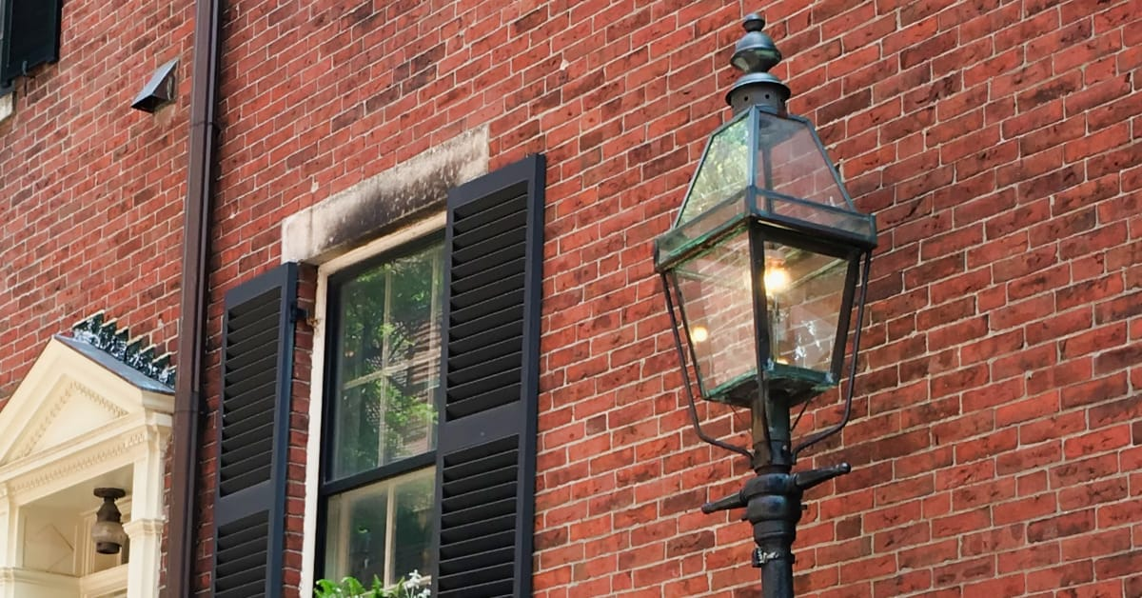
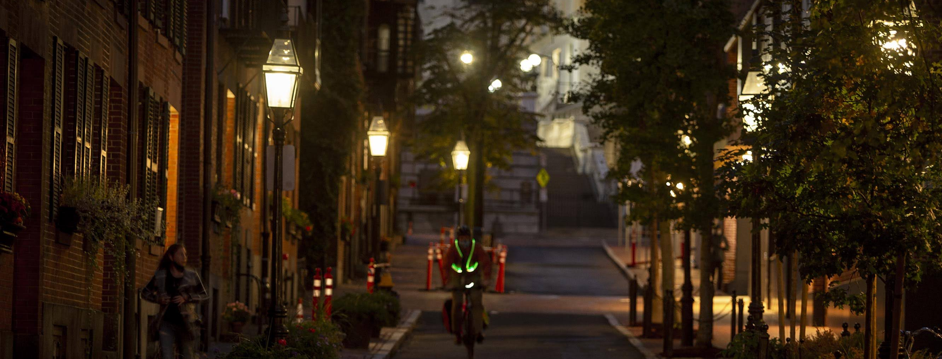
INDUSTRIAL DESIGN
DESIGN
VELOCITY
Inspired by Boston’s historic, natural gas lamps
Modularity for easy access
Slanted solar panels to capture solar power
Notes:
Elaine

Slide 6
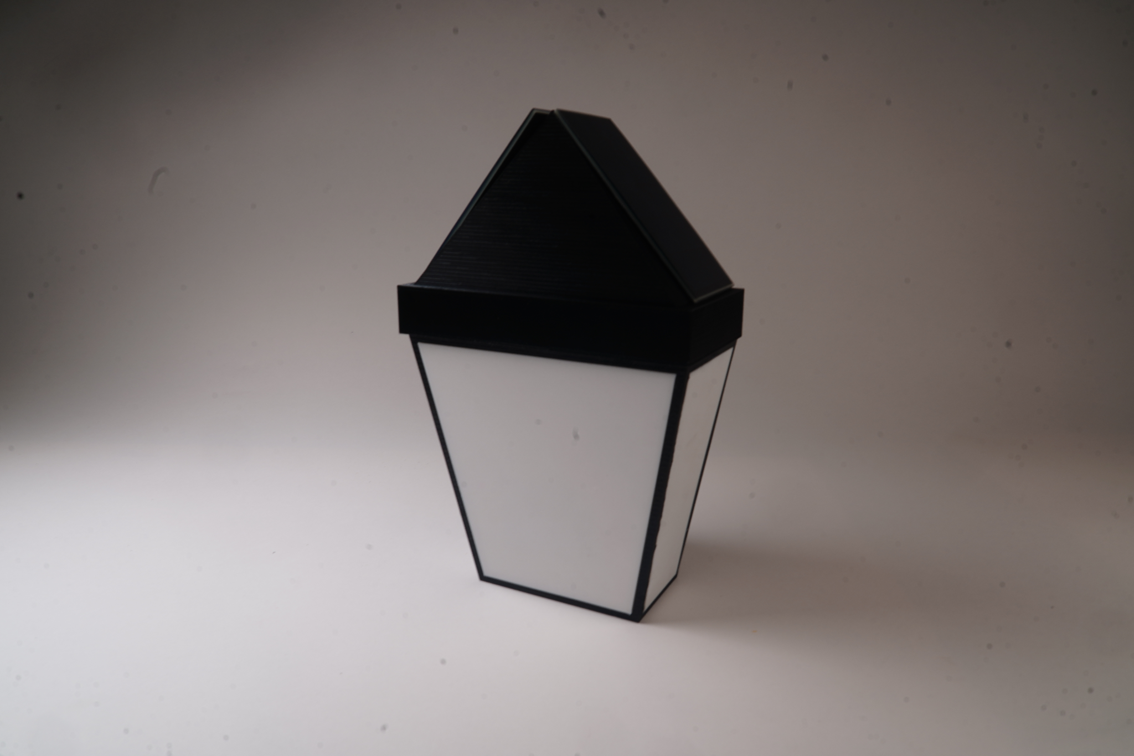
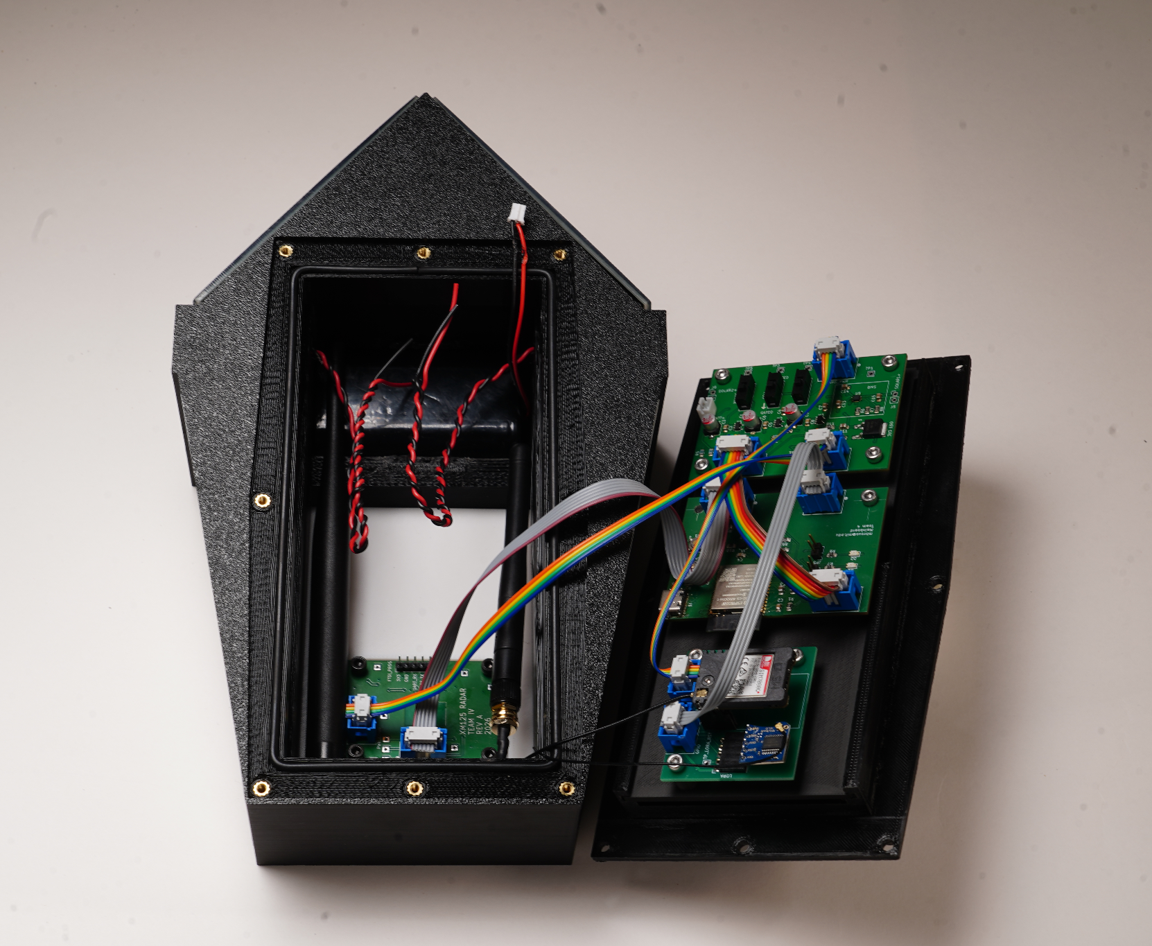
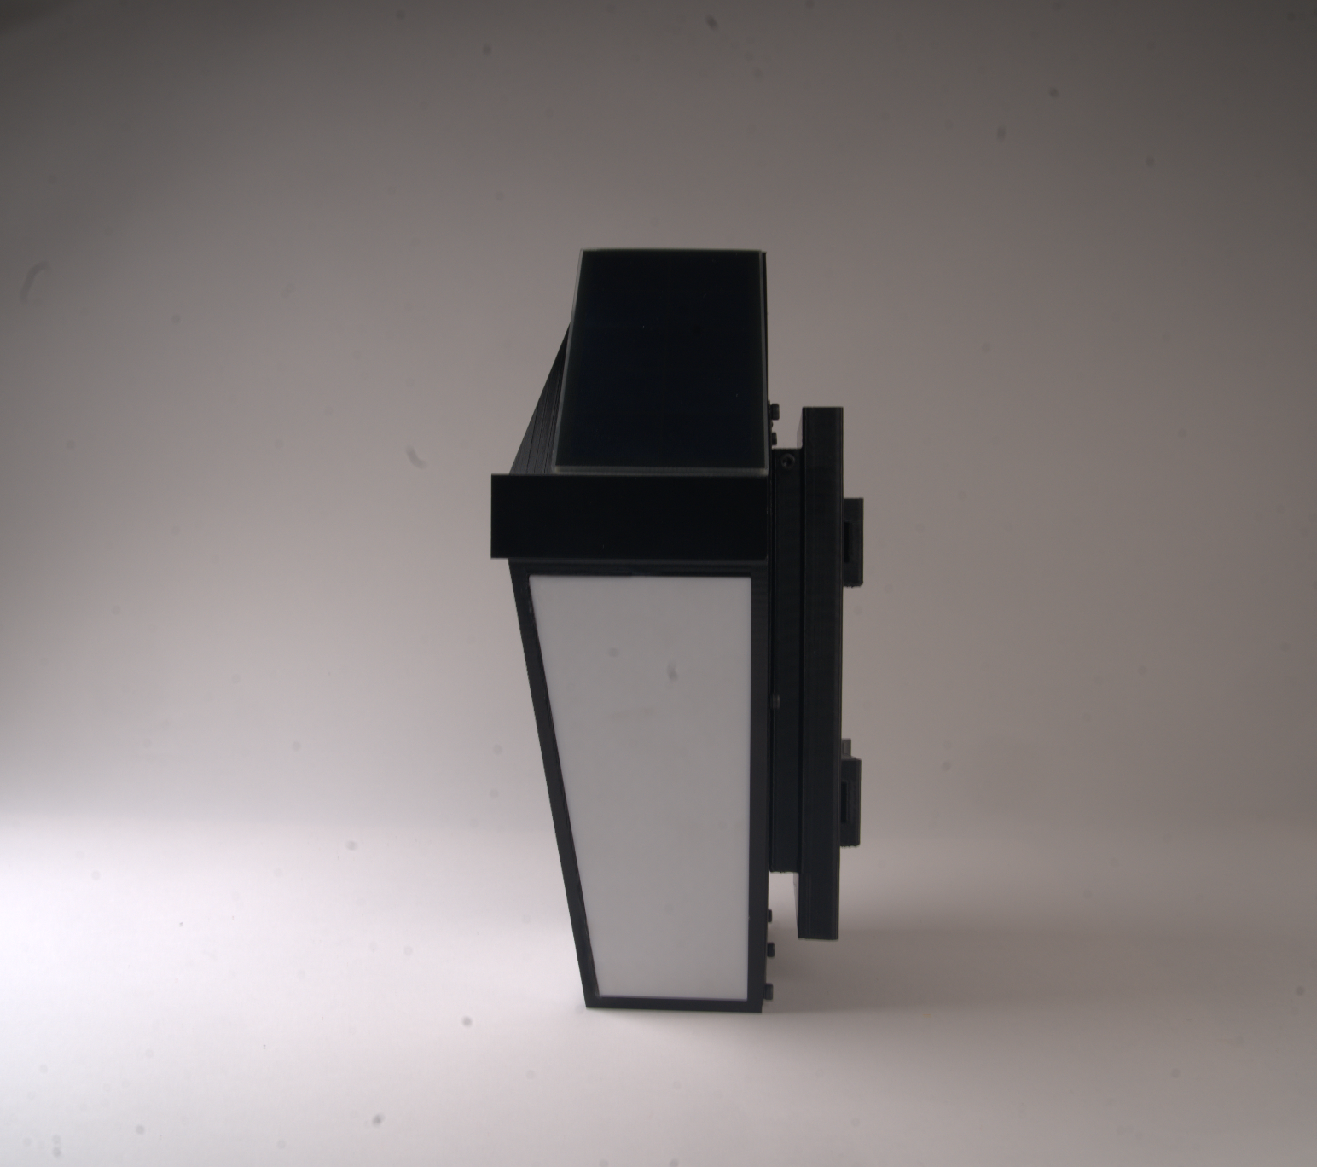
DESIGN
VELOCITY
SOLAR PANELS TO RECHARGE BATTERY
SIDE PANELS TO ENHANCE LAMP AESTHETIC
MOUNTED ELECTRONICS
DETACHABLE, POLE-MOUNTABLE BACKING FOR EASIER ACCESS
– MOUNTED AT 5 FT WITH STEEL HOSE CLAMPS
RADAR SENSOR PANEL TO DETECT BIKERS AND THEIR VELOCITY
– ANGLED ~45° TOWARDS THE BIKE LANE

Slide 7
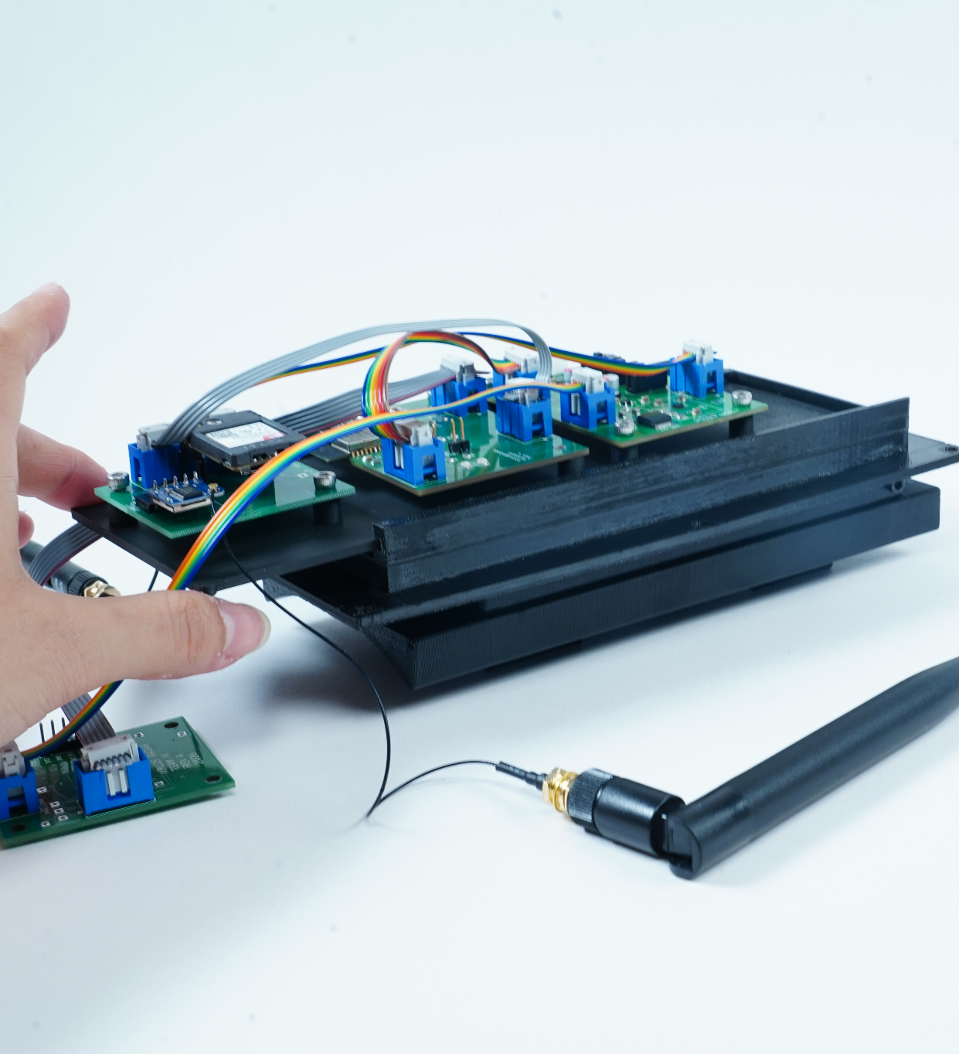
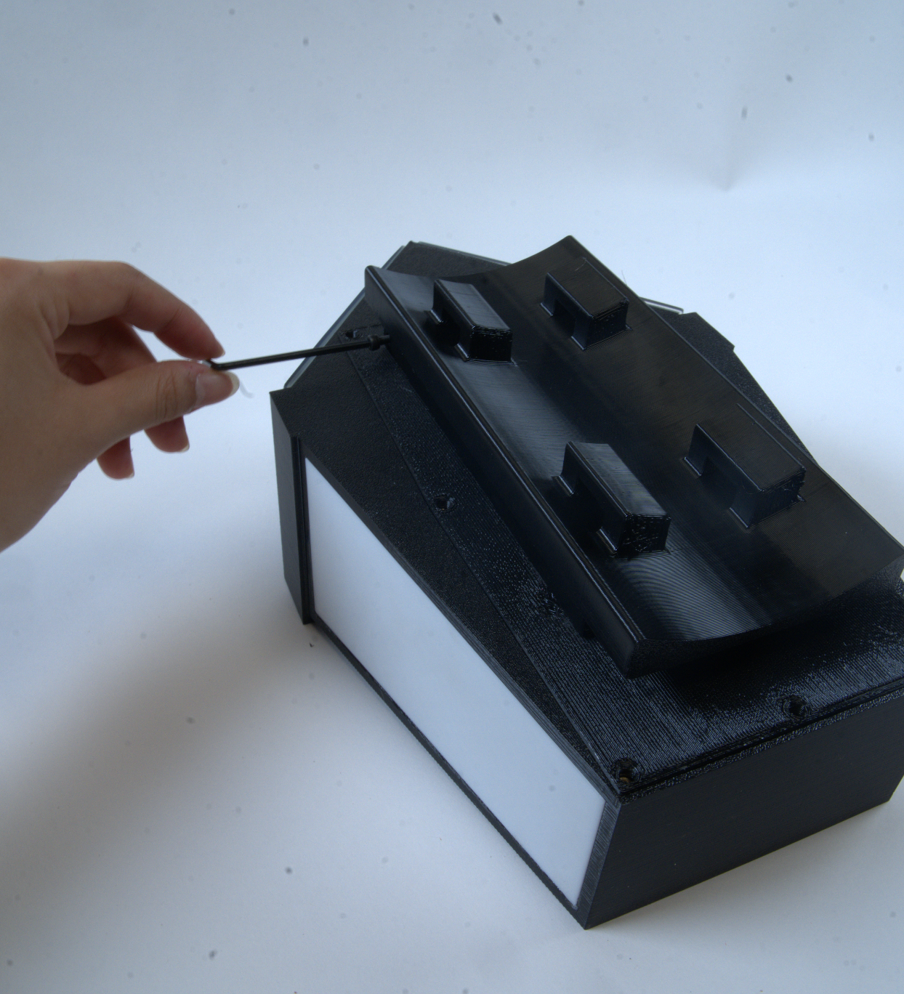
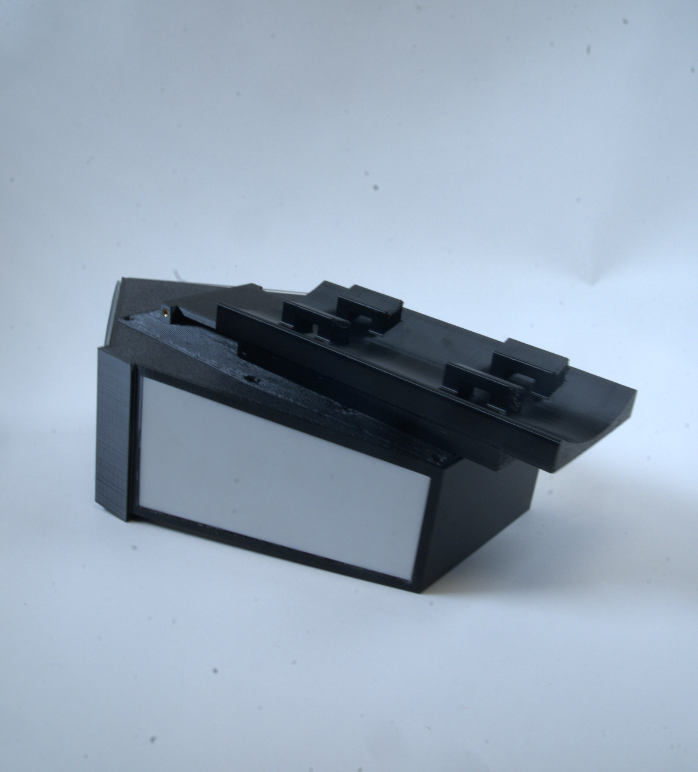
SLIDING POLE ATTACHMENT FOR EASY ACCESS
MOUNTING BOARD PLATE FOR ELECTRONICS
SIDE SCREW FOR SECURITY
DESIGN
VELOCITY
Pole attachment slides onto screw-in lid.
Board plate slides into screw-in lid.
Pole attachment screws into lid to prevent theft.
Notes:
Elaine

Slide 8
Key Specifications
SPECIFICATIONS
VELOCITY
Core System Goals
◉ Cyclist Detection
Counts bicycles and the direction of travel (+ velocity, pedestrians)
⌁ Off Grid Power
Rechargeable Li-Ion Battery + Solar powered operation
⇄ Wireless Reporting
LoRa network with Cell gateway upload
⛨ Privacy Preserving
No cameras or personal data collected
Deployment Features
⌘ Easy Installation
Pole mounted, no roadway modification
☁ Outdoor Operation
Designed for year round weather exposure
⟳ Low Maintenance
Autonomous long term deployment
◎ Scalable System
Supports multiple deployed sensor nodes
Notes:
Max

Slide 9
BOM/COGS
SPECIFICATIONS
VELOCITY
Electronics: | $65.26
Enclosure: | $40.79
Assembly: | $25.00
Total (COGS): | $131.05
BOM: $106.05
Hub device
Electronics: | $41.96
Enclosure: | $40.79
Assembly: | $25.00
Total (COGS): | $107.75
BOM: $82.75
Node device
Notes:
Yusuf

Slide 10
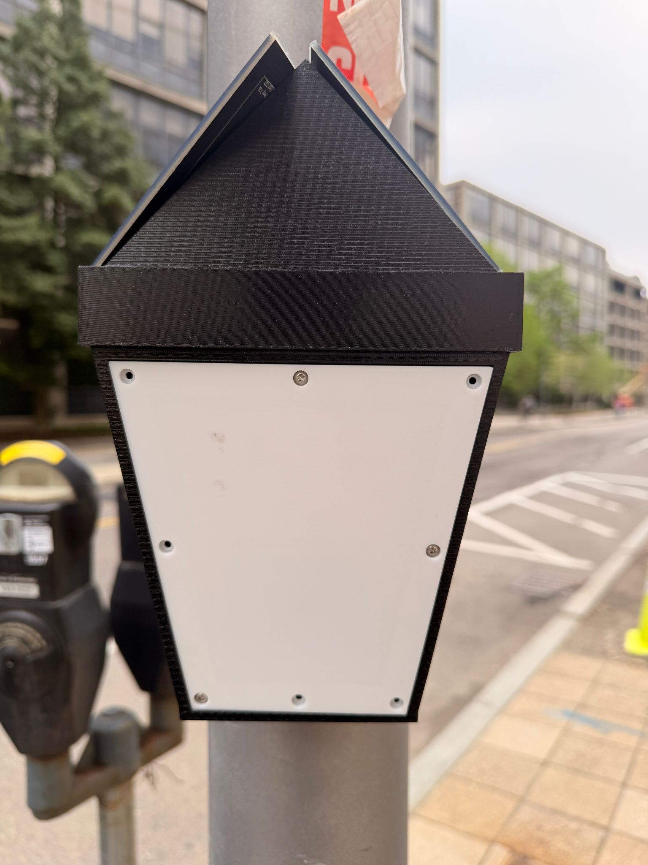
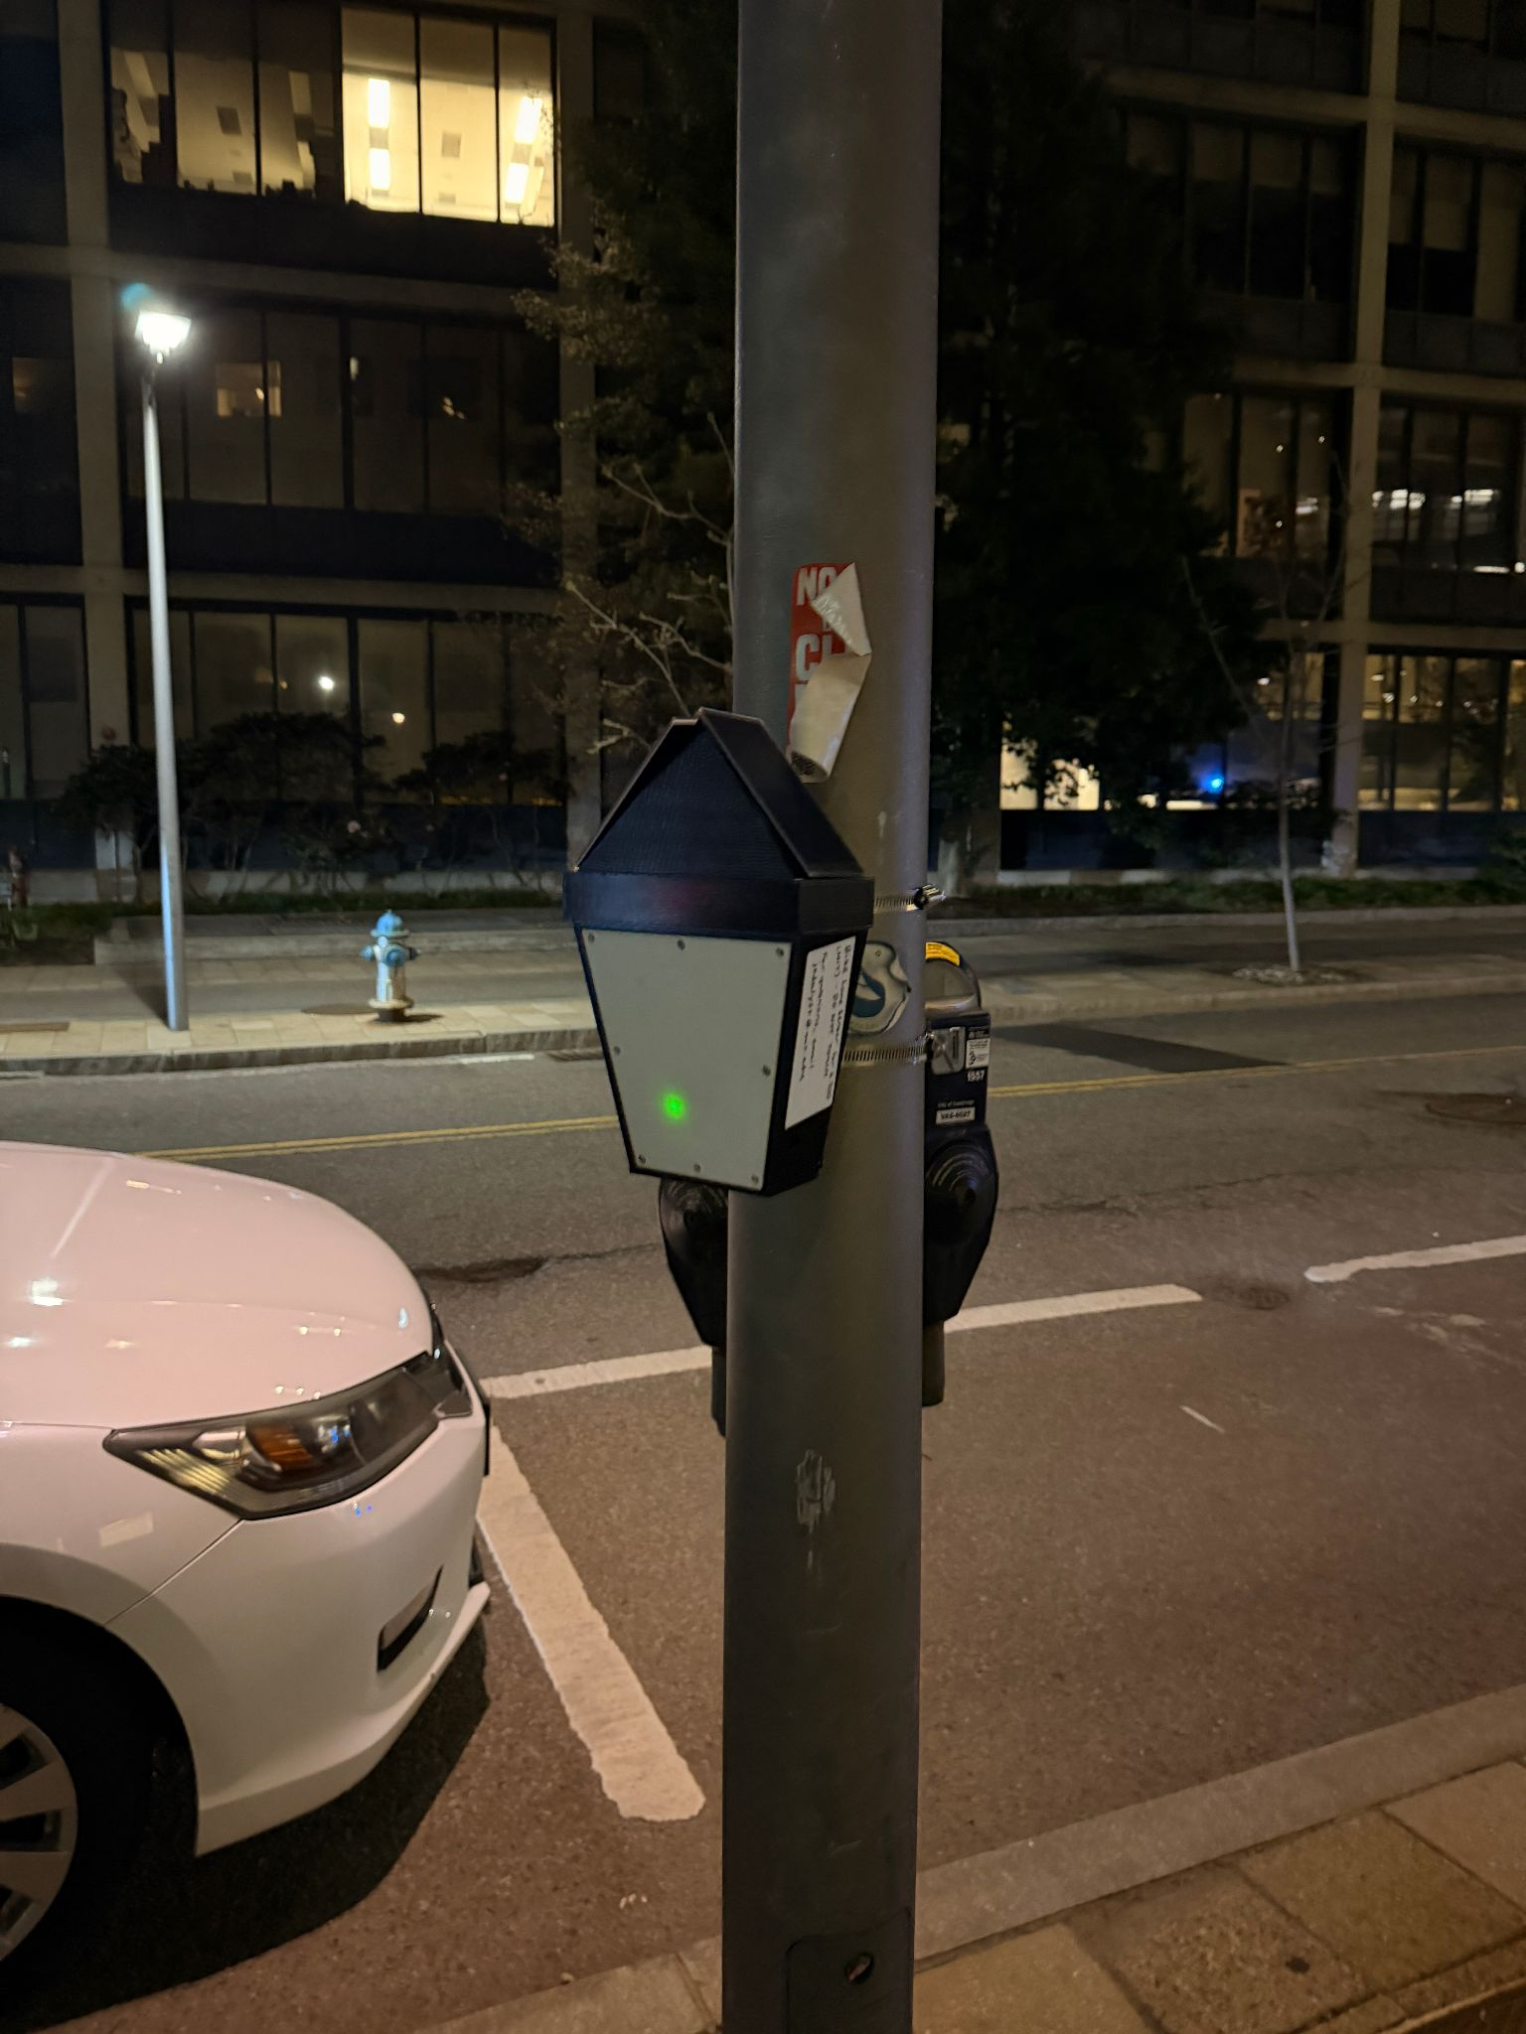
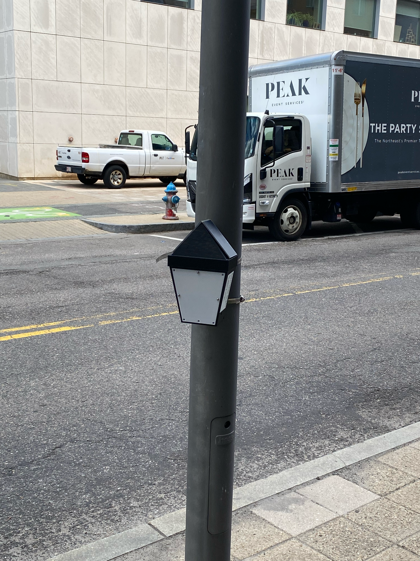
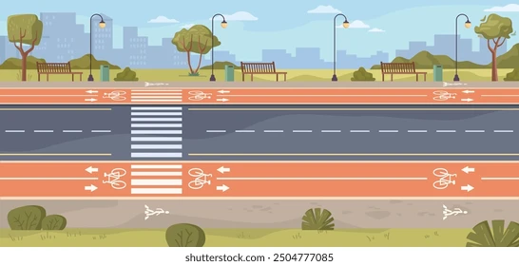
Live Demonstration
LIVE DATA
VELOCITY
Interactive Website: https://efpi-14.mit.edu/
Notes:
Fernando

Slide 11
THANK YOU!
Qs?
Notes:
Fernando

